Slide 1
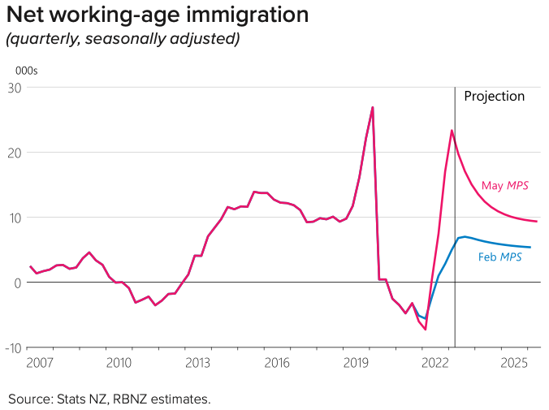
Population growth, politics and interest rates
100,000 net migration
Possible National/ACT government
Or third Labour term
Tax outlooks differ
Mortgage rates to fall?
Depends on inflation, but it is falling globally

Slide 2
‘Yay. It’s my 6th…and maybe last…’
Grant Robertson
Presenting Budget 2023
His 6th Budget.
His 5th Wellbeing Budget
His last? Or 4th to last?
Median voters to decide

Slide 3
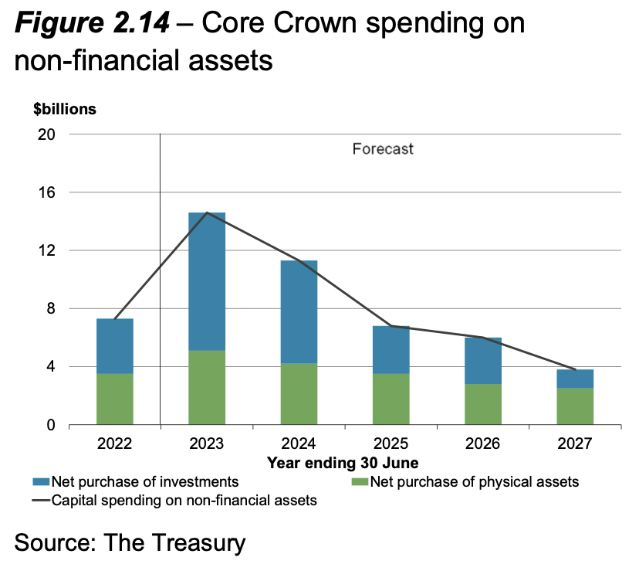
Highlights, lowlights and cliffhangers
One year of new homes
One year of school lunches
One year of apprenticeship boosts
Two year olds into kindys
$5 prescription fee scrapped
Rebates for games developers
No recession

Slide 4
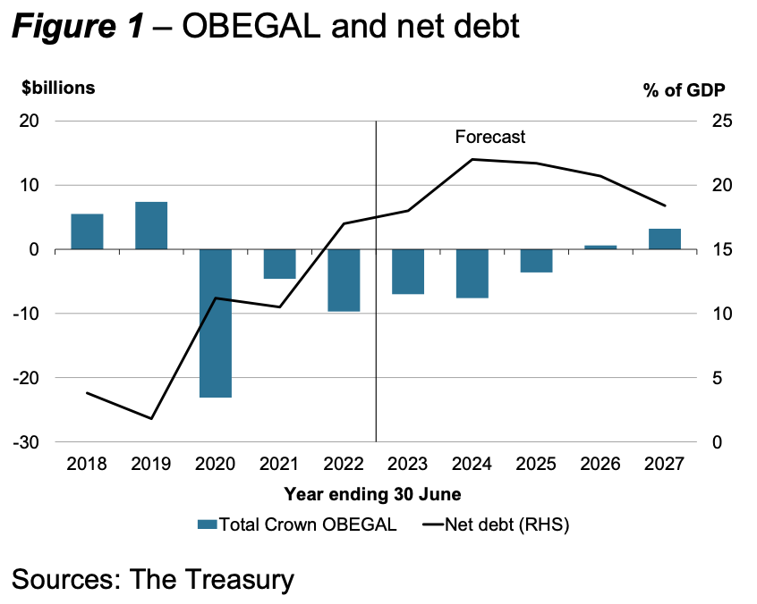
Highlights, lowlights and cliffhangers
Surplus one year later
Extra operational spend
Squeezed climate fund
Cyclone repairs
Expansive policy this year
Then contractionary later
RBNZ let it slide

Slide 5
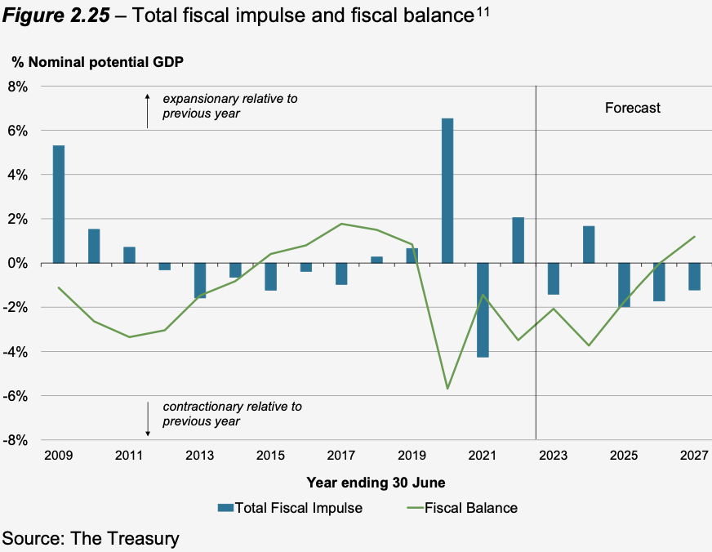
Highlights, lowlights and cliffhangers
Trust rate up to 39% from 33%
5% of trusts do 78% of income
Tax hike to raise $1.1b in 4 yrs
311 families = $14.6b income
311 families = $85b in wealth
311 families – 9.5% tax rate
Vs PAYEs on 30%
Will we have a tax debate?

Slide 6
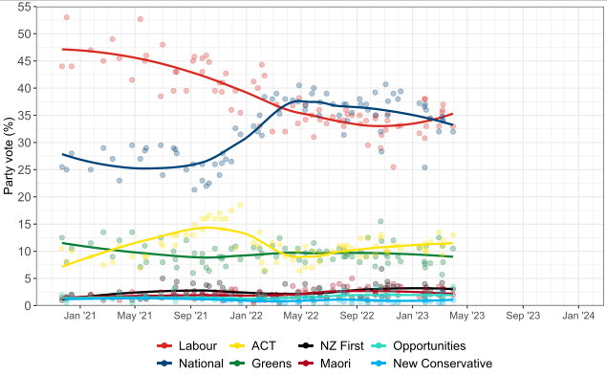
Oct 14 election was National’s to lose
November 2021 pivot
Voting 4 months away
Budget bonanza? No
Inflation falling
Luxon gaffe prone
Hipkins started solidly
Watch TOP and TPM
Too close to call

Slide 7
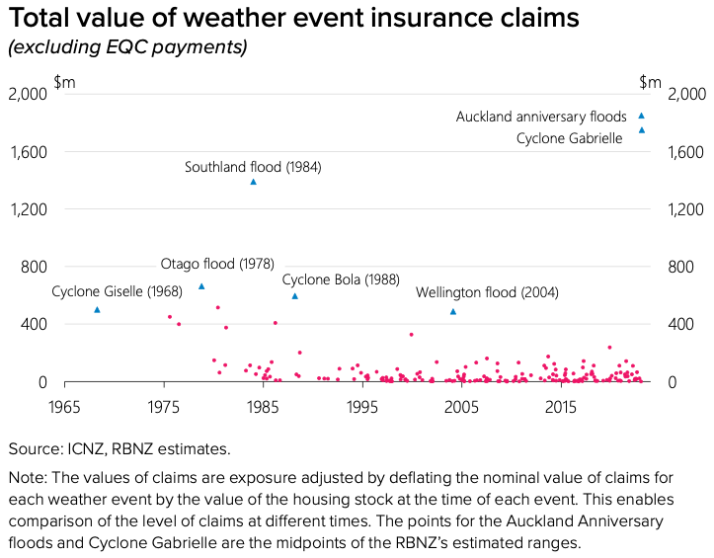
Summer was coming The rain came instead
Mortgage rates are peaking ~6%
House prices are bottoming out
Inflation to fall
Weekly incomes are rising 8% p/a

Slide 8
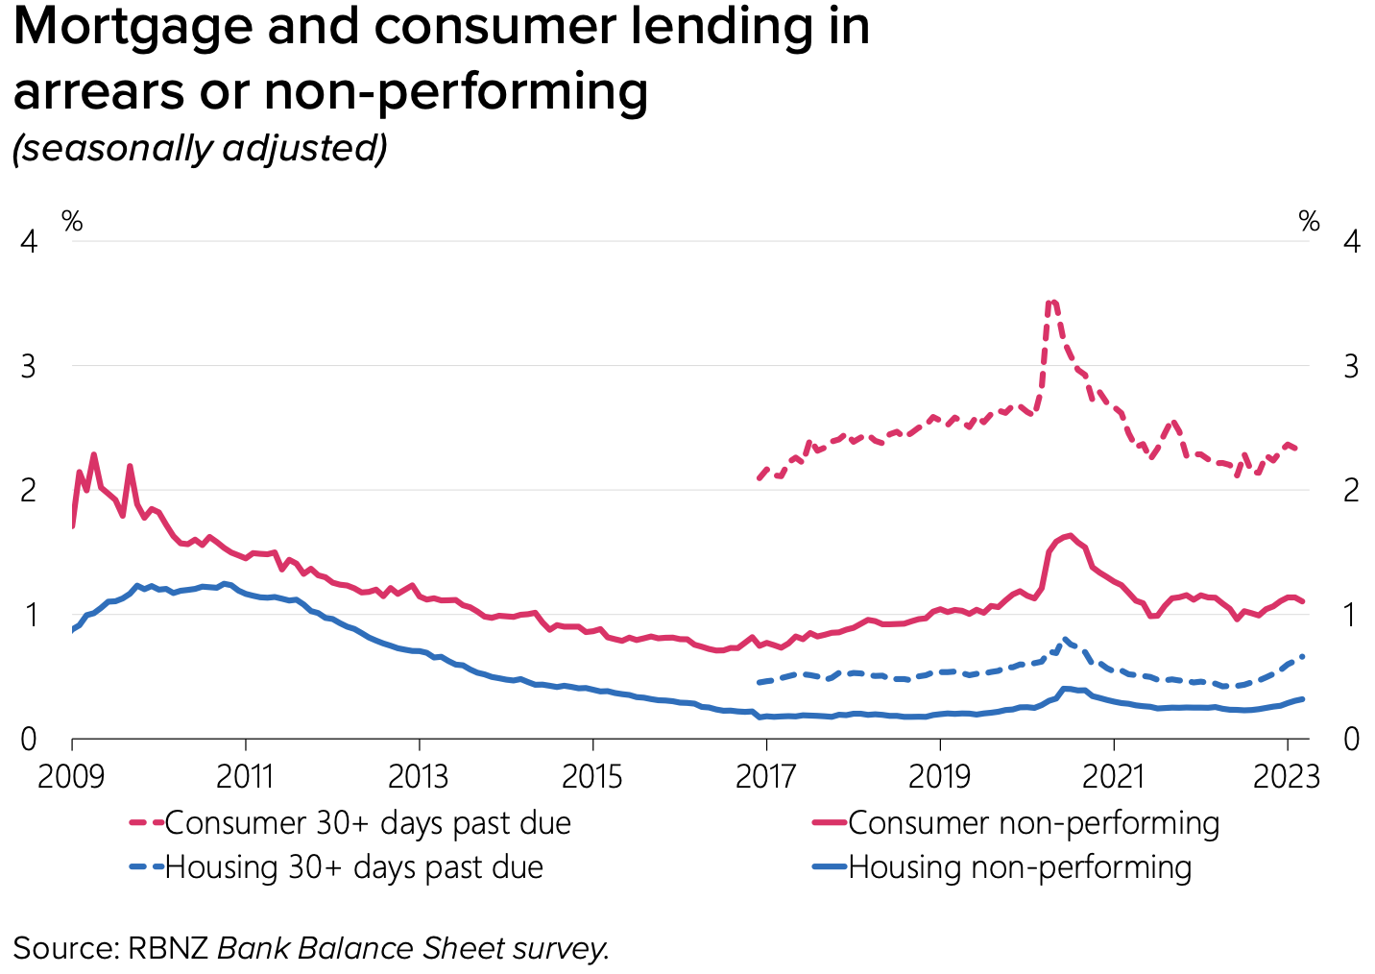
We’re much healthier than we feel
We say we’re down, but we still spend
Home-owners are cash & equity rich
Household, corp & govt debt v. low

Slide 9
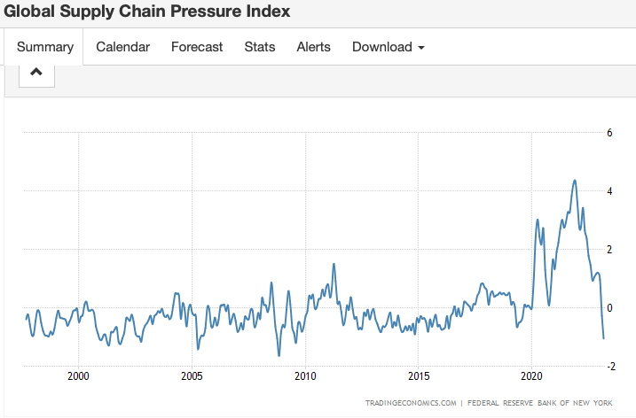
Supply chains are clearing
Input inflation rates falling globally
Container rates down 60% from peaks
China, Europe & US sucking inflation down

Slide 10
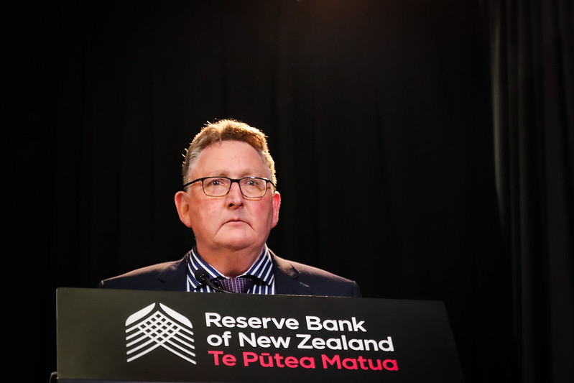
Fire(starter)fighter says he’s done
OCR ↑ .25% = 5.5%
Peak of 5.5%
House prices ↓ 20%
LVRs easing in June
Owner-occupier >80% speed limit: 10% to 15%
Rental investors high LVR from 60% to 65%

Slide 11
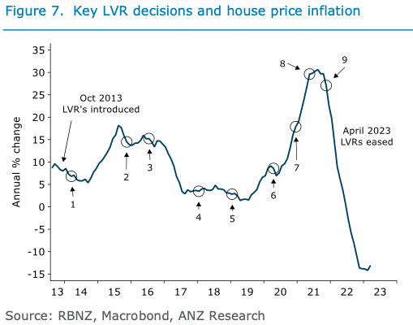
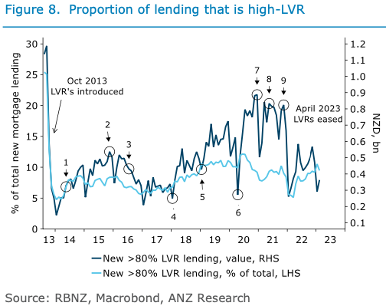
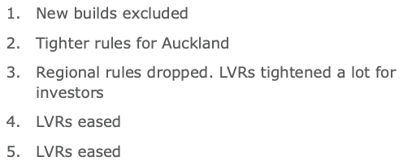
LVR loosening will help

Slide 12
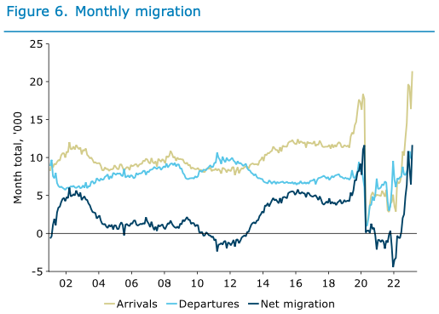
Net migration too. Double forecasts

Slide 13
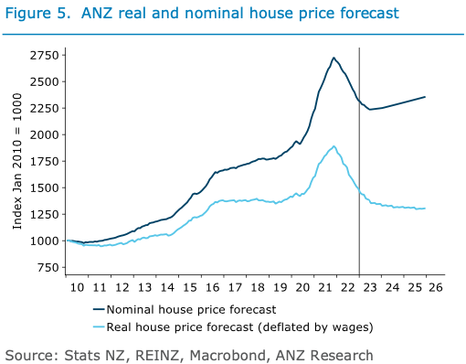
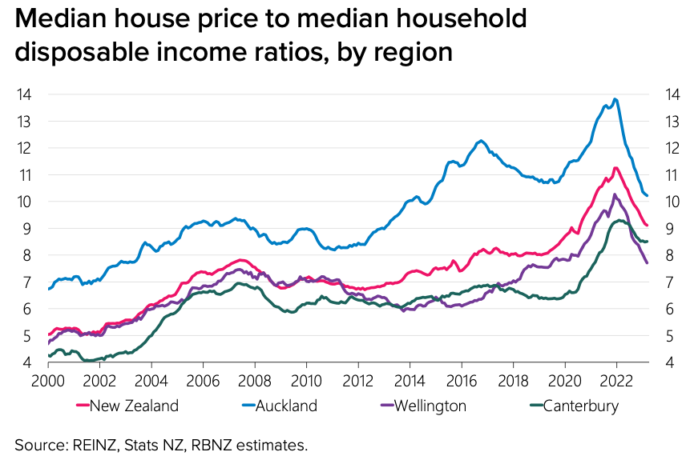
Sustainable and (less) un-affordable

Slide 14
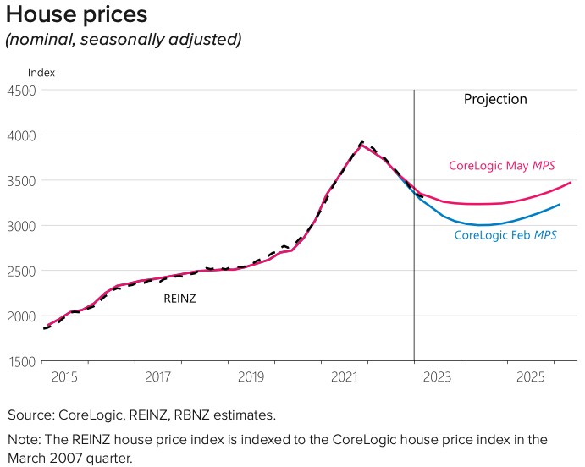
What happens next?
Mortgage rates peaking
Average still rising
But still at Feb 2020
Peak around 5.5%-6.0%
Test rates were 6-7%
Test rates now 8-9%

Slide 15
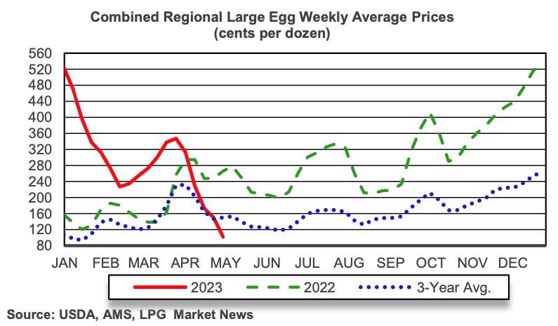
Inflation is subsiding globally
Producer price inputs ↓
Fuel, shipping, chips
European, US & Chinese economies slowing, but may avoid recession
Fastest tightening in decades

Slide 16
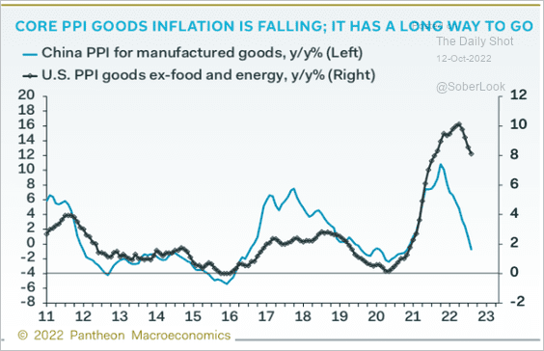
Global recession? No so much
Brutal jump in US rates
But US house building not slumping so much
China ends zero covid policy & apart-mageddon
Europe in better straits
War continues into summer

