Slide 2
Minimum Standards
Install Smoke Alarms
Insulation:
Existing to 1978 standards
New to current standards
July 2019 ...

Slide 3
Healthy Housing Bill
Insulation to current standards
Fixed form of heating...

Slide 4
Methamphetamine
NZ Standards
Contamination levels 0.5 to 1.5micrograms
Standardised testing and remediation Co’s
Self Testing with conditions
NZPIF protocol
Business relationships...

Slide 5
Unlawful Dwellings
Anderson v FM Custodians
Andersons were squatting
Rest Home consent
Consent conflicted with the RTA
High Court ruled dwelling to be unlawful
Tenancy Tribunal has no jurisdiction
High court considered potential injustice to landlords but did not want to give a measure of legitimacy to letting arrangements ...

Slide 6
Unlawful Dwellings
RTA clause 137: Prohibited transactions
All money paid ... Shall be recoverable as a debt due to the tenant...by the landlord

Slide 7
Unlawful Dwellings
Previous tenants sought 9 months rent to be paid back
Tenant had taken the benefit of accommodation
No complaints during the tenancy
Claim was opportunistic and dismissed...

Slide 8
Unlawful Dwellings
Solutions
Residential Tenancies Amendment Bill
Minister of Housing: Unrealistic to expect anything sooner
Tenancy Tribunal: Procedural changes
Court of Appeal
Two remaining options we are pursuing...

Slide 9
Unlawful Dwellings
1. Tribunal Adjudicators finding
High Court went away from the key point
Cases not related to squatters in a rest home is advice rather than a binding ruling
Tribunal does have jurisdiction on other unlawful premises
Dunedin Landlords appeal ...

Slide 10
Unlawful Dwellings
2. Legal opinion from Chen Palmer
Check your properties
Get a Code of acceptance...

Slide 11
Election
?

Slide 12
Cost of Ring Fencing losses
Providing the average NZ home as a rental
Property Value (REINZ NZ Median house price) |  | $529,000
Deposit / Investment | 10% | $52,900
Mortgage |  | $476,100
Mortgage Interest rate |  | 5.86%
Weekly Rent |  | $520
Annual rent |  | $27,040
Expenses |  | $37,301
Cost in first year |  | -$10,261
Tax Refund (Inc chattels Depn) | 33.00% | -$4,084
Owners cost |  | -$6,177

Slide 13
Future cost issues
Repairs and maintenance
WOF
Ring fencing losses
Capital gains tax
Property management fees ...

Slide 15
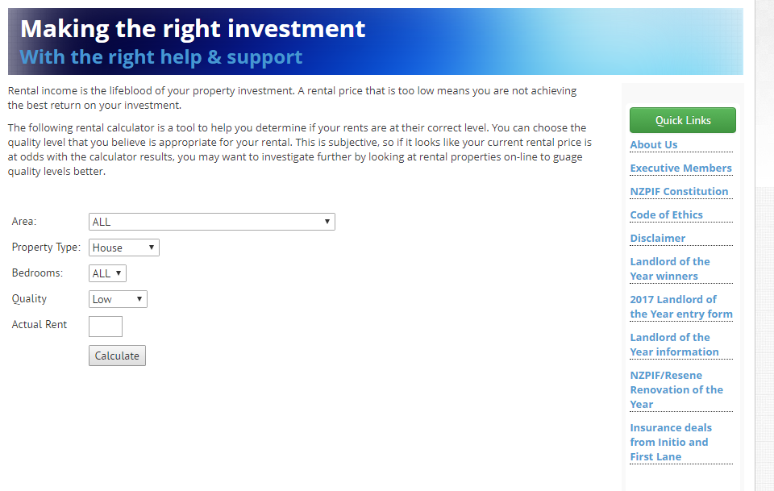

Slide 16
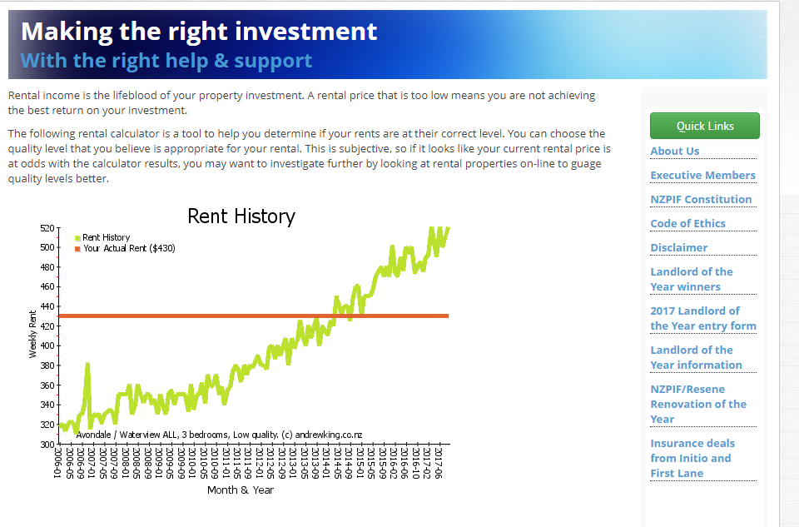

Slide 17
Security of tenure
No intention of selling 49.2%
At least 10 years 12.7%

Slide 18
Effect of losing a rental property
 | Number of occupants | Number of Dwellings | Occupants per dwelling
All homes | 4,242,051 | 1,549,890 | 2.74
Owner occupied | 2,112,747 | 1,003,575 | 2.11
Rented | 2,129,304 | 546,315 | 3.90

Slide 19
Policies affecting property investors…
 | National | Labour | NZ First | Greens
WoF | No | Within first 100 days in office | No | Yes
CGT | No | All but said yes. Previously 15% | Yes for Foreign owners No for NZers | Yes. Income tax rate (ex-family home)
Bright Line Test | Existing 2 Years | 5 Years | No comment | 5 Years
Ring fencing losses | No | Yes | No comment | No comment
Heating & insulation stds | Minimum standards introduced | Healthy Homes Bill $2,000 grant | Healthy Homes Bill | Healthy Homes Bill
Toughen RTA | No | No clause notice. 90 days if selling Annual rent reviews | Yes | No clause notice 90 days if selling Annual rent reviews Advocates Encourage long leases Tenants anonymous Automatic right of renewal

Slide 20
Affordability
National | Labour | NZ First | Greens
Build 34,000 homes (5,000 state homes, 7,000 affordable homes) | Build 100,000 starter homes over 10 years | Long term sale agreements for land to first home buyers | Labours policy plus build 10,000 rent to buy homes
Introduced Special Housing Areas – fast track consents | Less red tape on affordable homes | 2% mortgage interest for first 5 years | Fund 3rd sector to provide 1,000 houses a year
Urban Development Authority | Affordable Housing Authority | 2% loans to councils for elderly and social rental housing | Increase minimum wage – 66% of average wage
Introduced $25pw benefits Increase accommodation supplement. Tax deductions | Copy National policy apart from tax deductions | Copy National policy | Copy National policy
Already introduced Kiwisaver / Welcome home Increased to $20,000 | Discourage rental property investment |  | Low rate mortgages for low income households
$1 billion Housing Infrastructure Fund
Reform RMA

Slide 21
Effect of losing a rental property
 | Number of occupants | Number of Dwellings | Occupants per dwelling
All homes | 4,242,051 | 1,549,890 | 2.74

Slide 22
Effect of losing a rental property
 | Number of occupants | Number of Dwellings | Occupants per dwelling
All homes | 4,242,051 | 1,549,890 | 2.74
Owner occupied | 2,112,747 | 1,003,575 | 2.11

Slide 30
