Slide 1
Napier NZPIF Update on Brightline And Tax Deductibility Tauranga PIA 26th May 2021 Written by Sharon Cullwick (NZPIF Executive Officer)

Slide 2
About me
Sharon Cullwick
Investing since 1998
Currently President of HBPIA
Previously VP of Waikato PIA
Helped set up New Investors Group in Auckland 2002/2003
Have properties in Auckland, Hamilton and Hawkes Bay
Addicted to Property
Look after some properties, others under management

Slide 3
Disclaimer
NZPIF is a Not-For-profit Organisation and does not provide financial, legal, tax, or accounting advice. Information provided by, on behalf of, or under the auspices of NZPIF is necessarily of a general nature.
NZPIF and its officers and agents have no responsibility or liability of any kind to any person for such information.
NZPIF recommends you consult appropriate professional advisors before making any investment decision or entering into any investment or transaction.

Slide 4
Initio and First Lane Survey
Thanks for those that completed the NZPIF Survey.
We had 193 participants in the survey.
Feed back for both Initio and First Lane Insurance was positive so NZPIF will be renewing our business partnership with them for another three years

Slide 5
Business Partner update
Carpet court has recently purchased curtain studio.
NZPIF now have them as a business partner.
Special pricing is available for members

Slide 6
NZPIF has again secured two awards for the 2021 year
Landlord of the Year sponsored by Ministry of Business Innovation and Employment
NZPIF/Resene Renovation of the Year

Slide 7
Landlord of the Year
Winner receives $1,000 cash and $1,000 towards registration to the 2021 NZPIF Conference, flights and accommodation for one.
Landlord of the Year Cup (for 12 months)
Framed Certificate
Kudos of being the Landlord of the year – this is a great way to grow your personal profile.
$500 to the winner’s PIA
Details can be found here: https://www.nzpif.org.nz/items/view/60199

Slide 8
NZPIF/Resene Renovation of the Year
$1,500 cash to winner
Renovation of the Year trophy
(for 12 months)
Framed Certificate
$500 to the winner’s PIA
Details can be found here:
https://www.nzpif.org.nz/items/view/60200

Slide 9
LLOTY and NZPIF/Resene Renovation - small print
You must be a member of a Property Investors’ Association
For LLOTY you must self manage at least some of your properties
For NZPIF/Resene Renovation you must have used Resene products and have a proof of purchase of these.
Applications close 6th August 2021 for both Awards.
See NZPIF web site for additional T&C’s under the menu heading About.

Slide 10
New NZPIF Forms
We have developed our own NZPIF Healthy Homes Compliance document.
New Tenancy Agreement Builder
This can be found on our web site.

Slide 11
Education Programme
There is places available this month
Free to members
$300 for non members
On line – Self Managing Landlords Course
Details can be found on NZPIF.org.nz
Enrol and then you will be sent a date you can start the course.

Slide 12
Education Program
This has been updated with the new changes to the RTA 2020
A link to the updates have been sent to people who have completed the course.

Slide 13
Rent Arrears Assistance Housing Support Product
This is a product to help tenants stay in their homes due to losing their jobs or reduced working hours
Tenants should contact Ministry of Social Development.
Available until July 2021
Tenants need to prove hardship and they will be asset tested.
This can help with overdue rent payments.
Tenants can get up to $4000 in a 12 month period.

Slide 14
Residential Tenancies Act 2020
This has now been updated as one document on the Government Legislation site

Slide 15
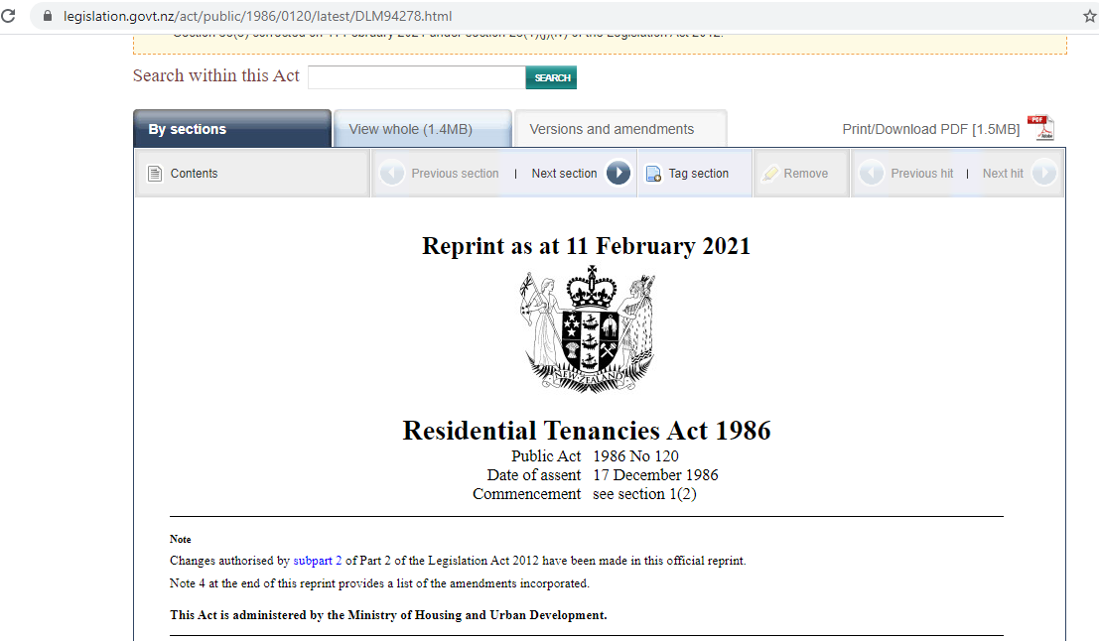

Slide 16
Budget 2021
$16 million for Compliance and Investigation Team on HHS enforcement
$41 million to tenancy services
$18 million operating and $20 million capital funding to ensure that the IT system to Bond Centre
$5 million to Tenancy Tribunal to manage increasing demand from the Residential Tenancies Amendment Act 2020.

Slide 17
23 March ‘21 changes
Housing Acceleration Fund
An infrastructure fund
Additional funding for the Government’s Land for Housing Programme

Slide 18
These will be complemented by:
Kāinga Ora Land Programme
A refocused $350 million Residential Development Response Fund.
Extension of the bright line test
Limit deductions for interest expenses on loans
First Home Products (First Home Grant and Loans) income and house price caps
A proposal to consult on limiting rent increases to once every 12 months per rental property (Link to page (rather than once every 12 months per tenancy), to help mitigate potential negative impacts on tenants from the tax changes.

Slide 19
Bright Line Test
Increased from 5 to 10 years
Excludes new builds (definition to be consulted on)
Applied to property acquired on or after 27 March 2021
Main homes and inherited property remain exempt. (some changes are occurring for a property that is both own home and a rental).
Tax is paid at your income tax rate - up to 39%
Already passed via a Bill

Slide 20
Removal of Interest Deductibility
Still in consultation
Removal of deductions for interest expenses on loans used to generate income from residential property.
New builds will be exempt, and the design of the exemption will be consulted on.
Applies from 1st October, 2021
Property purchased on or after 27th March 2021
Applies to all residential property by 2025.

Slide 21
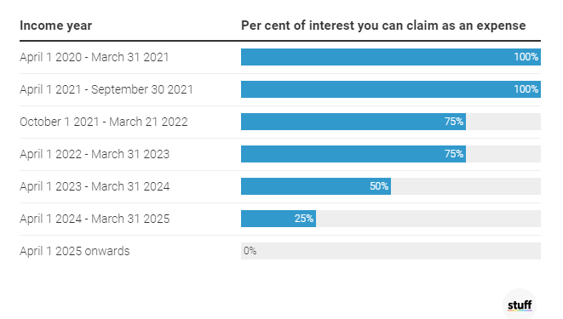
Interest Deductibility – pre-existing loans

Slide 22
Limit rent increase to once per year,
per property
Limit rent increases to once every 12 months per rental property (rather than once every 12 months per tenancy),
This is to help mitigate potential negative impacts on tenants from the tax changes.
Will involve a change to the RTA
In consultation

Slide 23
Survey Results
Thanks to the 1917 respondents of our survey
Conducted through survey monkey
Over 5 days after the tax deductibility announcement

Slide 24
Survey Respondents replies
Average of 5.3 properties
Average value $609,407
90% had debt on their properties
Average mortgage interest rate was 3.42%
Average increase in tax by removing interest deductibility was $15,083 per investor
Average increase in tax per property was $3140 per rental property
98% of respondents who bought rental property in the last two years are affected with a tax increase of $4,542 per year per property

Slide 25
Survey Respondents replies (continued)
78.8% of those investing for 20+ years being affected at a cost of $2,468 per year per property.
Cost of the extra tax could be $1.5 billion
Brightline Test - 69.2% of respondents did not think they would, or hoped they wouldn’t, be affected by the extension of the Bright Line Test.

Slide 26
Removal of mortgage interest tax deductibility survey results – continued
The main way to cope with the tax increase (76.8% of respondents), is to increase or probably increase rental prices. A further 8.9% might increase rental prices.
The median rental price increase is between $21 and $30 per week.
70.3% of respondents do not currently charge tenants full market level rental prices. 40% have rental prices between $5 and $25 under market value, while 30% have rental prices more than $25 pw under market value.

Slide 27
Brightline Test
Treasury wanted to extend this to 20 years.
Treasury never had time to work out the difference from 5 to 10 years
Expected fiscal gain is $650 million with the 10 years.
Treasury expect rents to rise due to this.
IRD opposed the 10 years
IRD wanted 5 years for new builds
Treasury wanted 20 years for new builds
Both were worried about the ‘lock-in’ effect

Slide 28
Tax Deductibility
IRD and Treasury didn’t agree to the changes
IRD opposed the changes and wanted to leave the status quo
Treasury never had enough time to do a Regulatory Impact Assessment.
Legislation will be written by 1st October.

Slide 29
Additional things that were on the table:
Ending interest-only loans – on investment properties.
The Reserve Bank were looking at bringing in debt-to-income (DTI) caps for mortgage lending.
Extending the Bright Line to 20 years.
The reintroduction of Stamp Duty.
Compulsory selling of vacant land for development.
Let’s see what happens!

Slide 30
NZPIF Lobbying
Bright Line – can’t change
Removal of Interest Deductibility
Still in consultation
Survey – now completed
Act Petition - we advise all members to sign – NB we have no political alliance
We have had a meeting with Government – David Parker, Megan Woods, Poto William and Grant Robertson
Meet with tenant groups and explain what this will mean for rents – Renters United, Tenant Protection

Slide 31
NZPIF Lobbying - continued
Limit Rent increase to once per year, per property
This requires a change in the RTA
Meet with Housing and Urban Development Team

Slide 32
Unintended consequences
Who do you sell a large apartment block to? They will need substantial cash
New investors may get in trouble if they purchased on capital growth, not on yield.
Who will buy investments?
What will happen in a couple of years when the tax deductibility starts to hurt people?

Slide 33
What can you do?
Send emails to Poto Williams and Grant Robertson, David Parker and Megan Woods
Poto’s moto: “My aspiration is for communities where everyone has a place, everyone has a voice and we are all loved.”
Rental increase once per tenancy – if you feel strongly about this send an email. – You may want to keep your current tenants at a reduced rent as they have some loyalty to you.

Slide 34
What’s next?
We don’t know, we can only guess
Rental indexing – unsure what exactly but know that HUD are working on this – they may link rents to CPI.
Rental caps – similar to the above but have a maximum amount you can charge for the size of the property. Poto Williams and Megan Woods have said this won’t happen.

Slide 35
What should you do?
Ensure your rents are at current rental rates for the property.
Use the NZPIF rent checker or use Trademe (don’t use the Tenancy Services data)
Keep a copy (photo) of how you worked this out – to keep the Compliance and Investigation Team happy.
Talk to your accountant if you are worried

Slide 36
Any questions

Slide 37
Other things NZPIF is working on:
Privacy Commission – ’Must have’ and ‘Nice to have’ lists
Commerce Commission – Cartel behaviour
Healthy Homes – specifically the heating tool and heat pumps
RTA changes – 90-day notice causing issues with property sales
Meth Standards
Insurance Council
Property managers – licensing
DTI – Reserve Bank
Interest-only loans – Reserve Bank
Research in Accommodation Supplement and Income Related Rent Subsidy

Slide 38
Napier
Thank you

