Slide 1
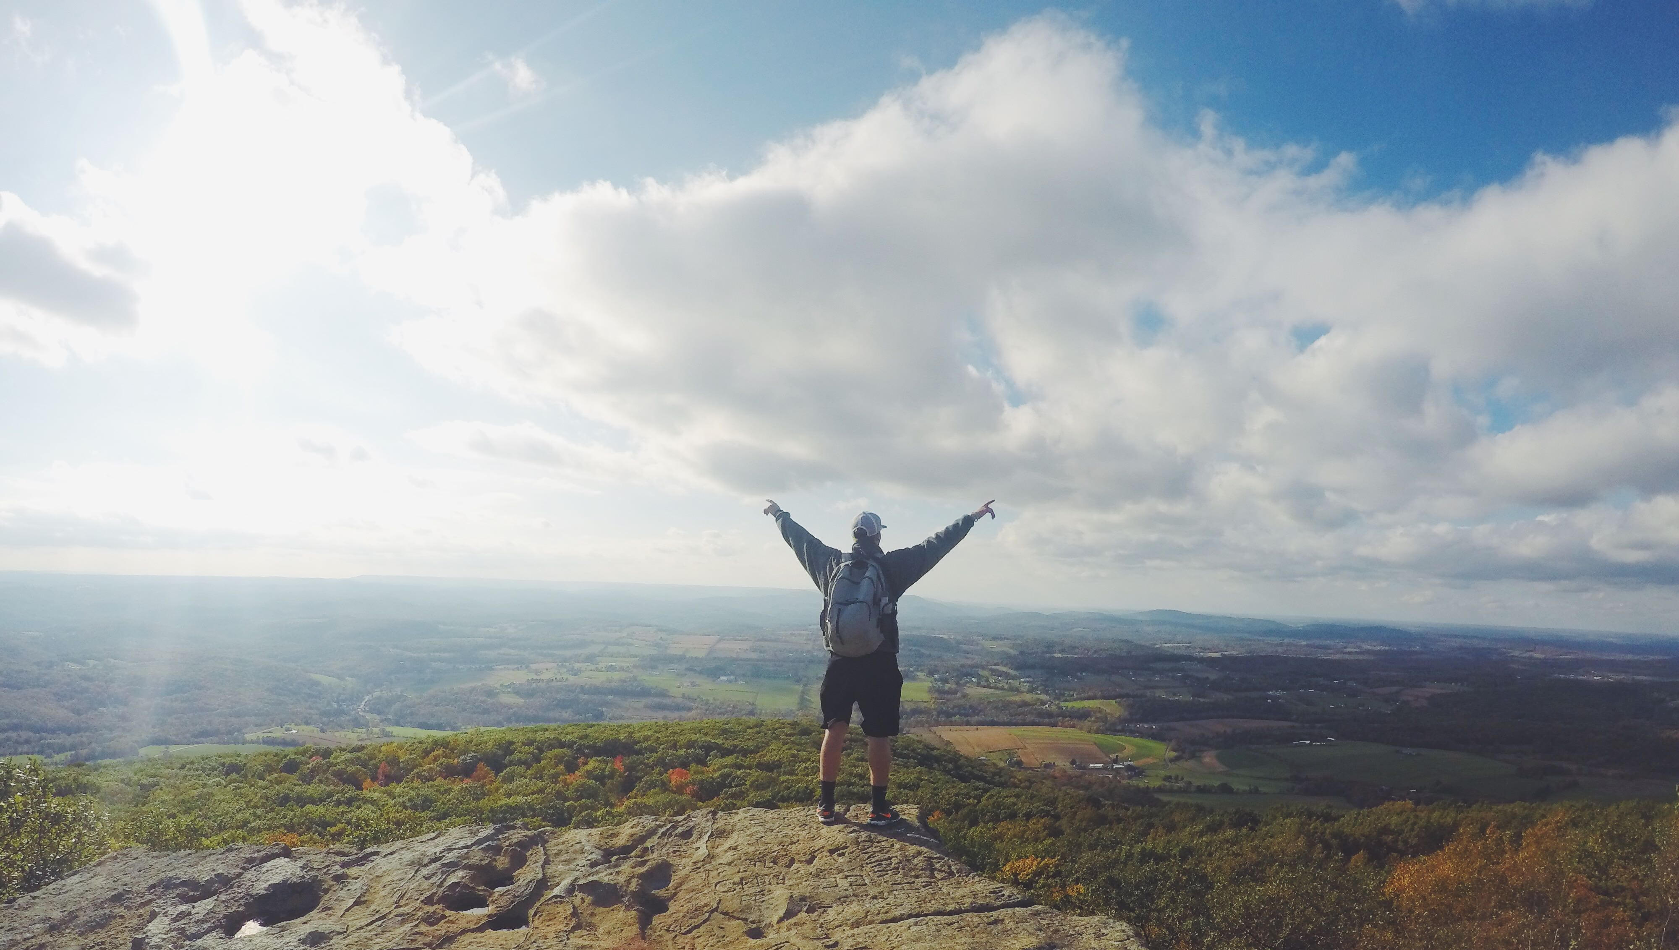
CLIMBING TO NEW HEIGHTS

Slide 2
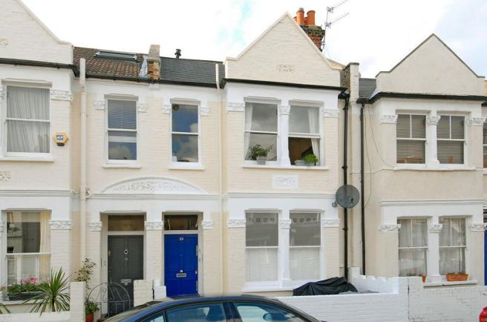
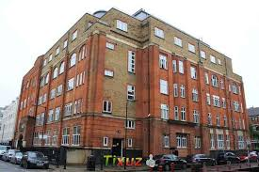
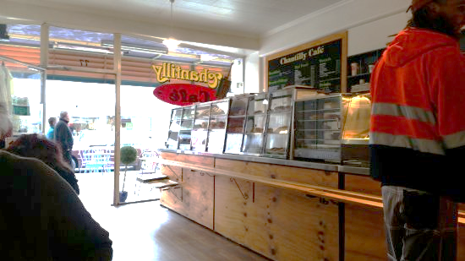
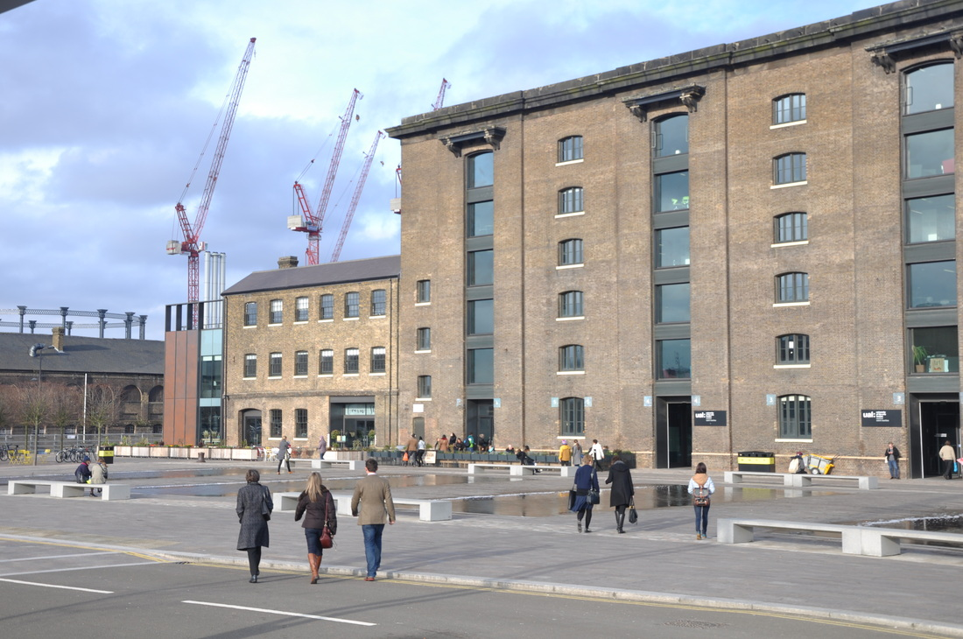
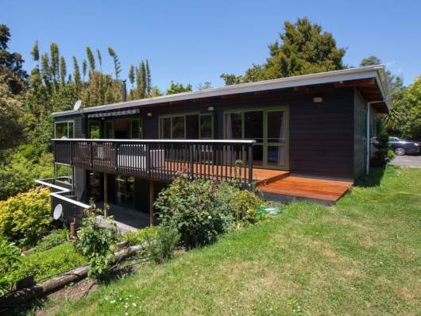

Slide 3
CREATIVE TENSION
TODAY’S REALITY
VISION

Slide 4
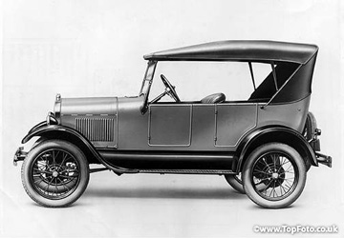
’
‘WHETHER WE THINK WE CAN
OR WE CAN’T
WE’RE RIGHT’
Henry Ford

Slide 5
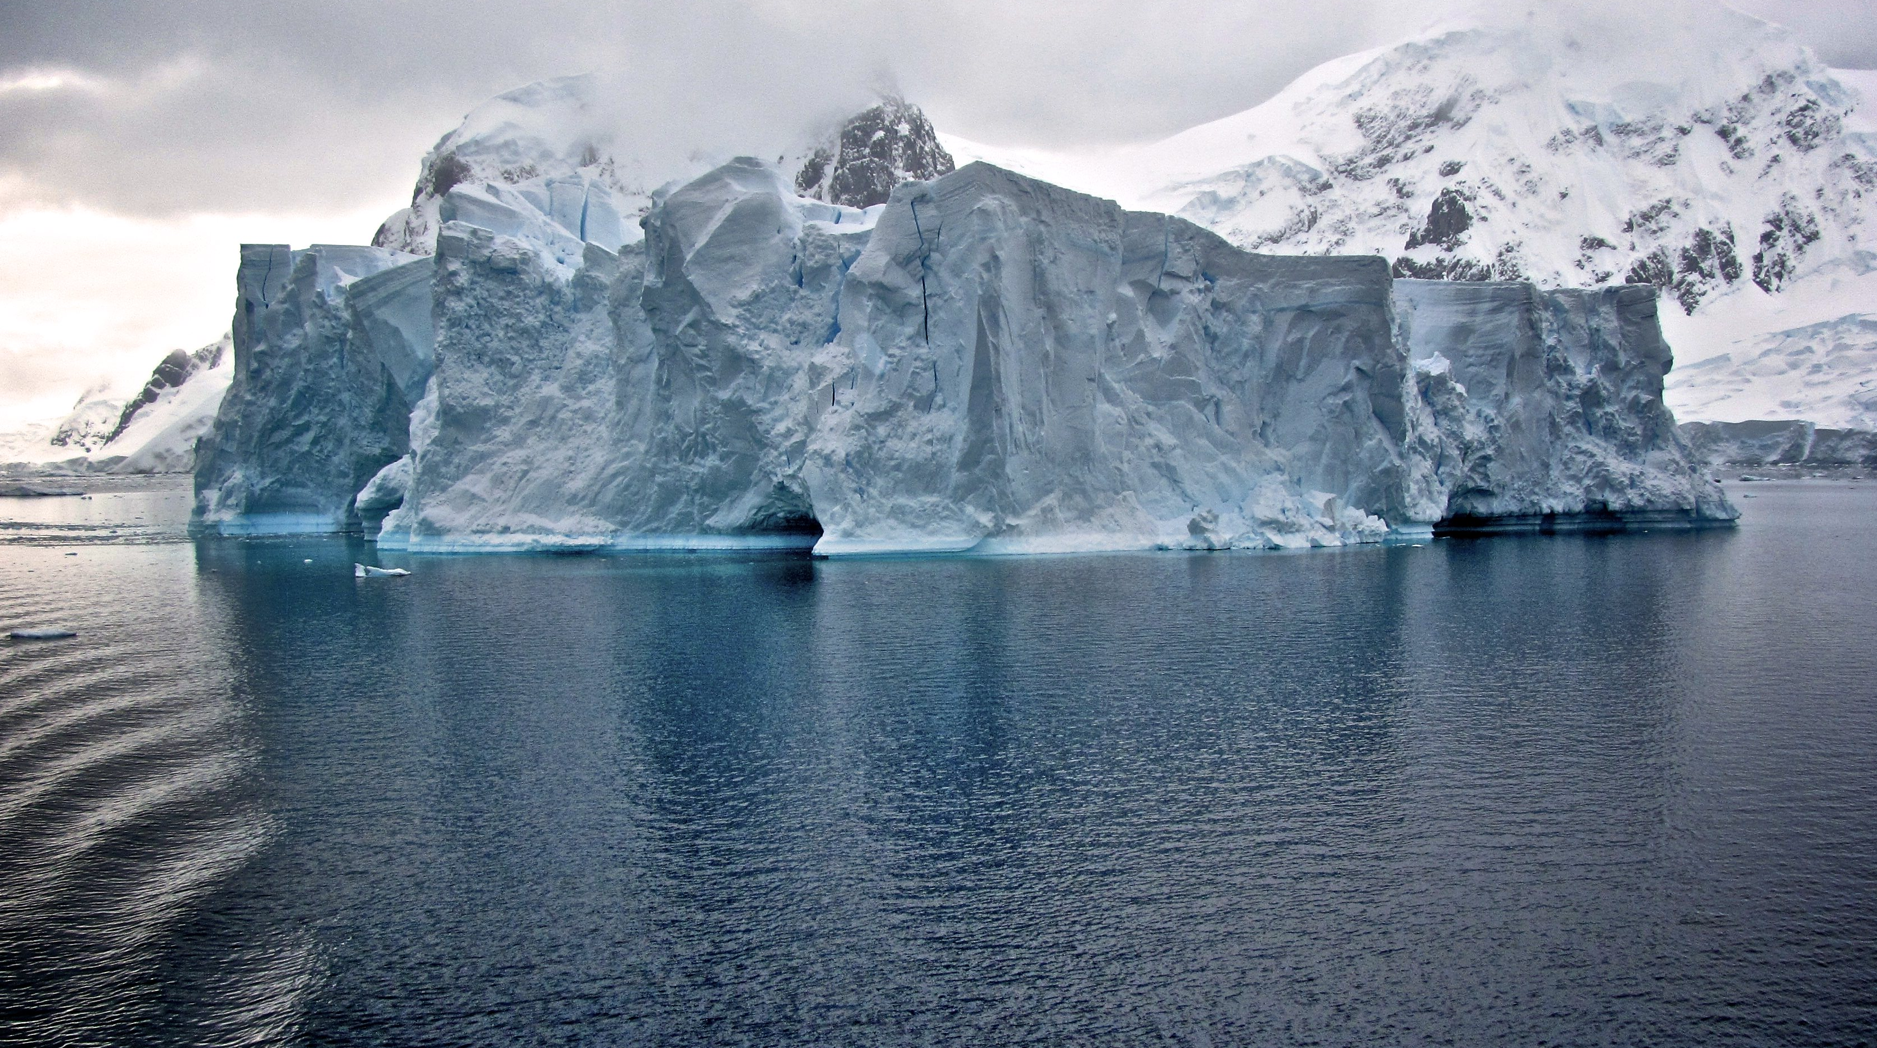
RESULTS
ACTIONS
EMOTIONS
THOUGHTS

Slide 6
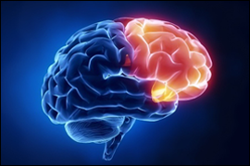
PRE-FRONTAL CORTEX
LONG TERM MEMORY

Slide 7
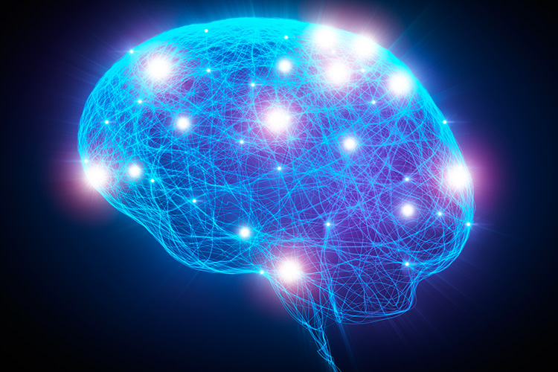
NETWORKS OF ASSOCIATIONS

Slide 8
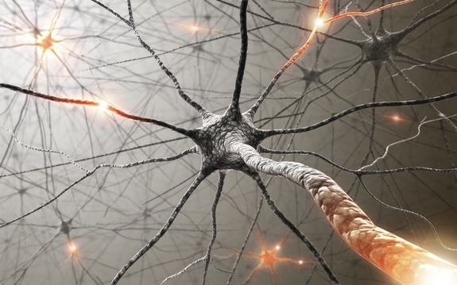
WHAT WE LEARN BECOMES HARD WIRING

Slide 9
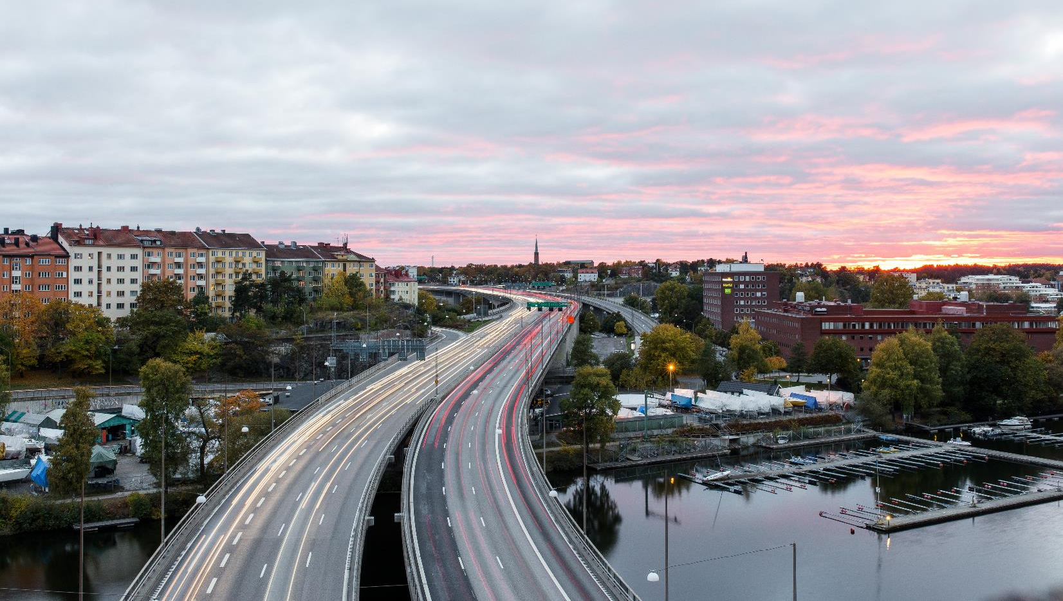
DEEP NEURAL PATHWAY

Slide 10
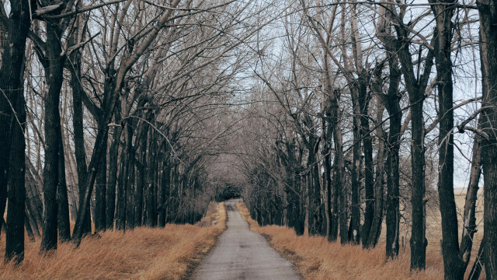
NEW NEURAL PATHWAY

Slide 11
B
H
A
G

Slide 12
BIG
HAIRY
AUDACIOUS
GOAL

Slide 13
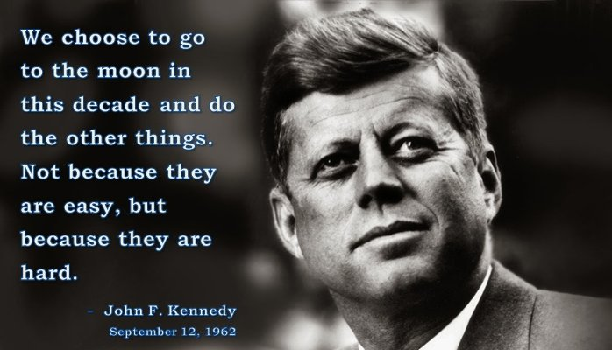

Slide 14
1. BIG
2. TAKE SEVERAL YEARS
3. NO IDEA HOW TO ACHIEVE IT
4. TANGIBLE

Slide 15
BHAG - 2021
Travel twice a year
Rich circle of family and friends
Healthy
My personal life bigger than work
Mortgage free
Annual adventure
Live by the sea
Be on a boat weekly

Slide 16
BIG
HAIRY
AUDACIOUS
GOAL

Slide 17
To travel widely, live by the sea, surrounded by friends and family, do work I love
BHAG - 2021
Travel twice a year
Rich circle of family and friends
Healthy
My personal life bigger than work
Mortgage free
Annual adventure
Live by the sea
Be on a boat weekly
To be free
by the sea

Slide 18
J
O
T

Slide 19
1. JUICY
2. OPTIMISTIC
3. TANGIBLE

Slide 20
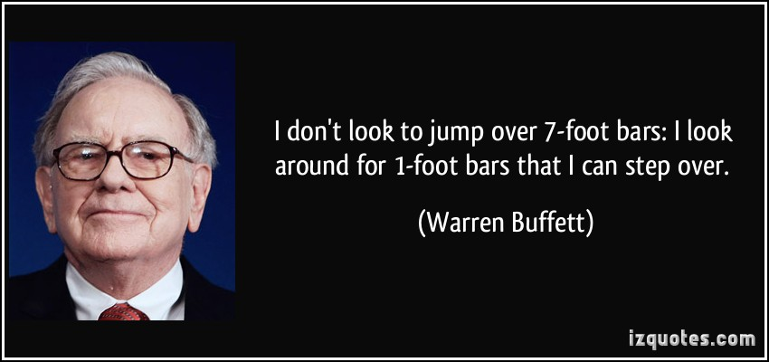

Slide 21
T
O
D
D

Slide 22
1. TASKS
2. ORGANISE
3. DIARISE; DO

Slide 23
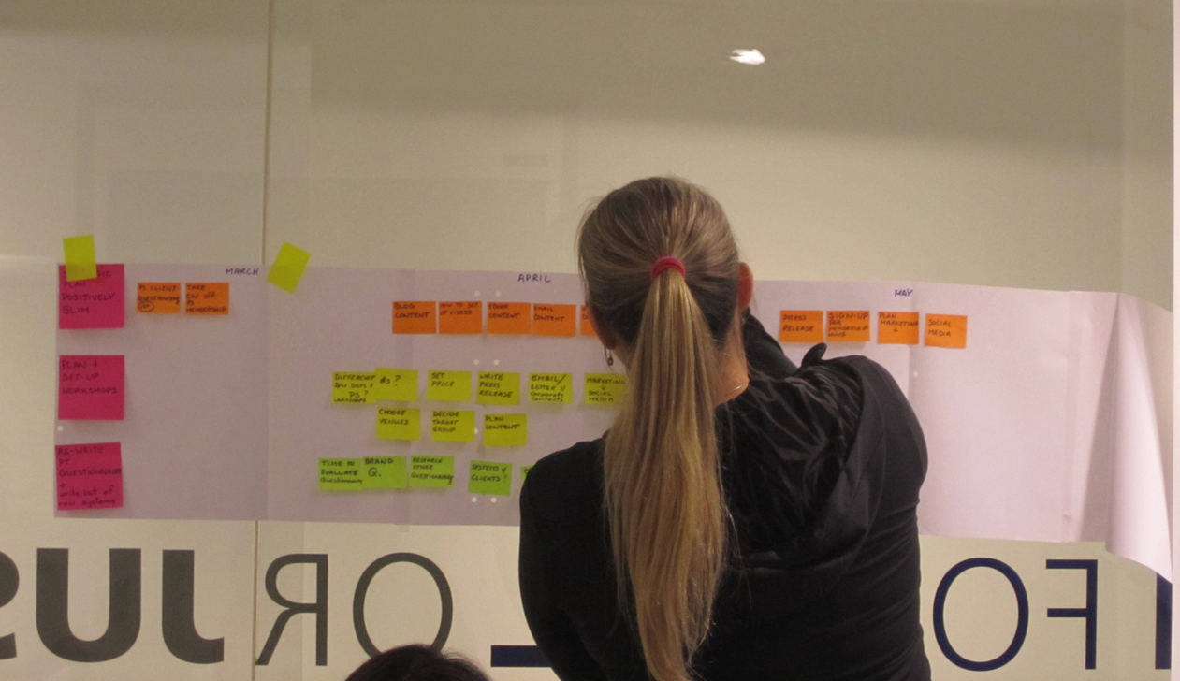

Slide 24
RESULTS
ACTIONS
EMOTIONS
THOUGHTS

Slide 26
1. THINK DELIBERATELY
2. 3 SUCCESSES DAILY
3. BHAG - CONNECT
4. SMILE - SHOWER

Slide 27
