Slide 1
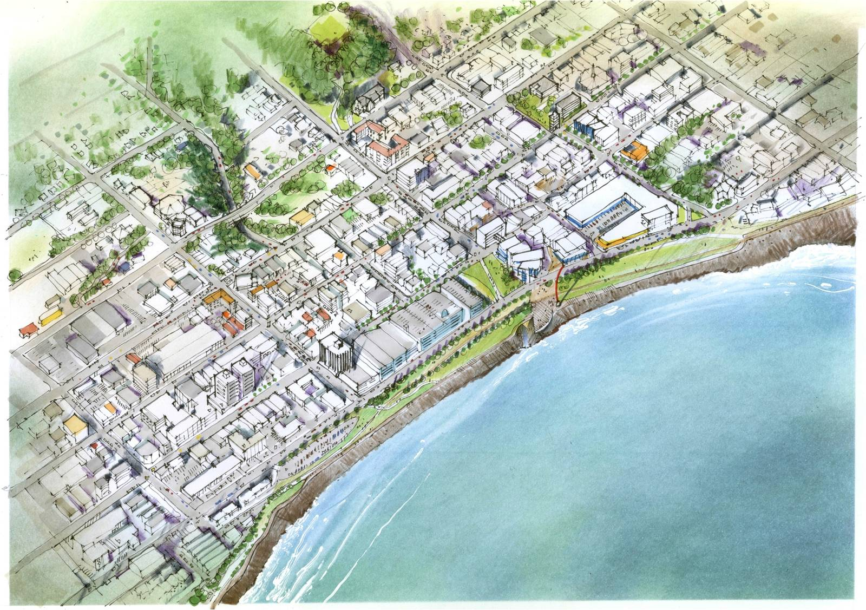
NZPIF Conference Liam Hodgetts – Group Manager Strategy New Plymouth District Council

Slide 2
Outline
Blueprint
The Stats: Our District
Challenges we face and our response
District Plan Review
Next steps

Slide 3
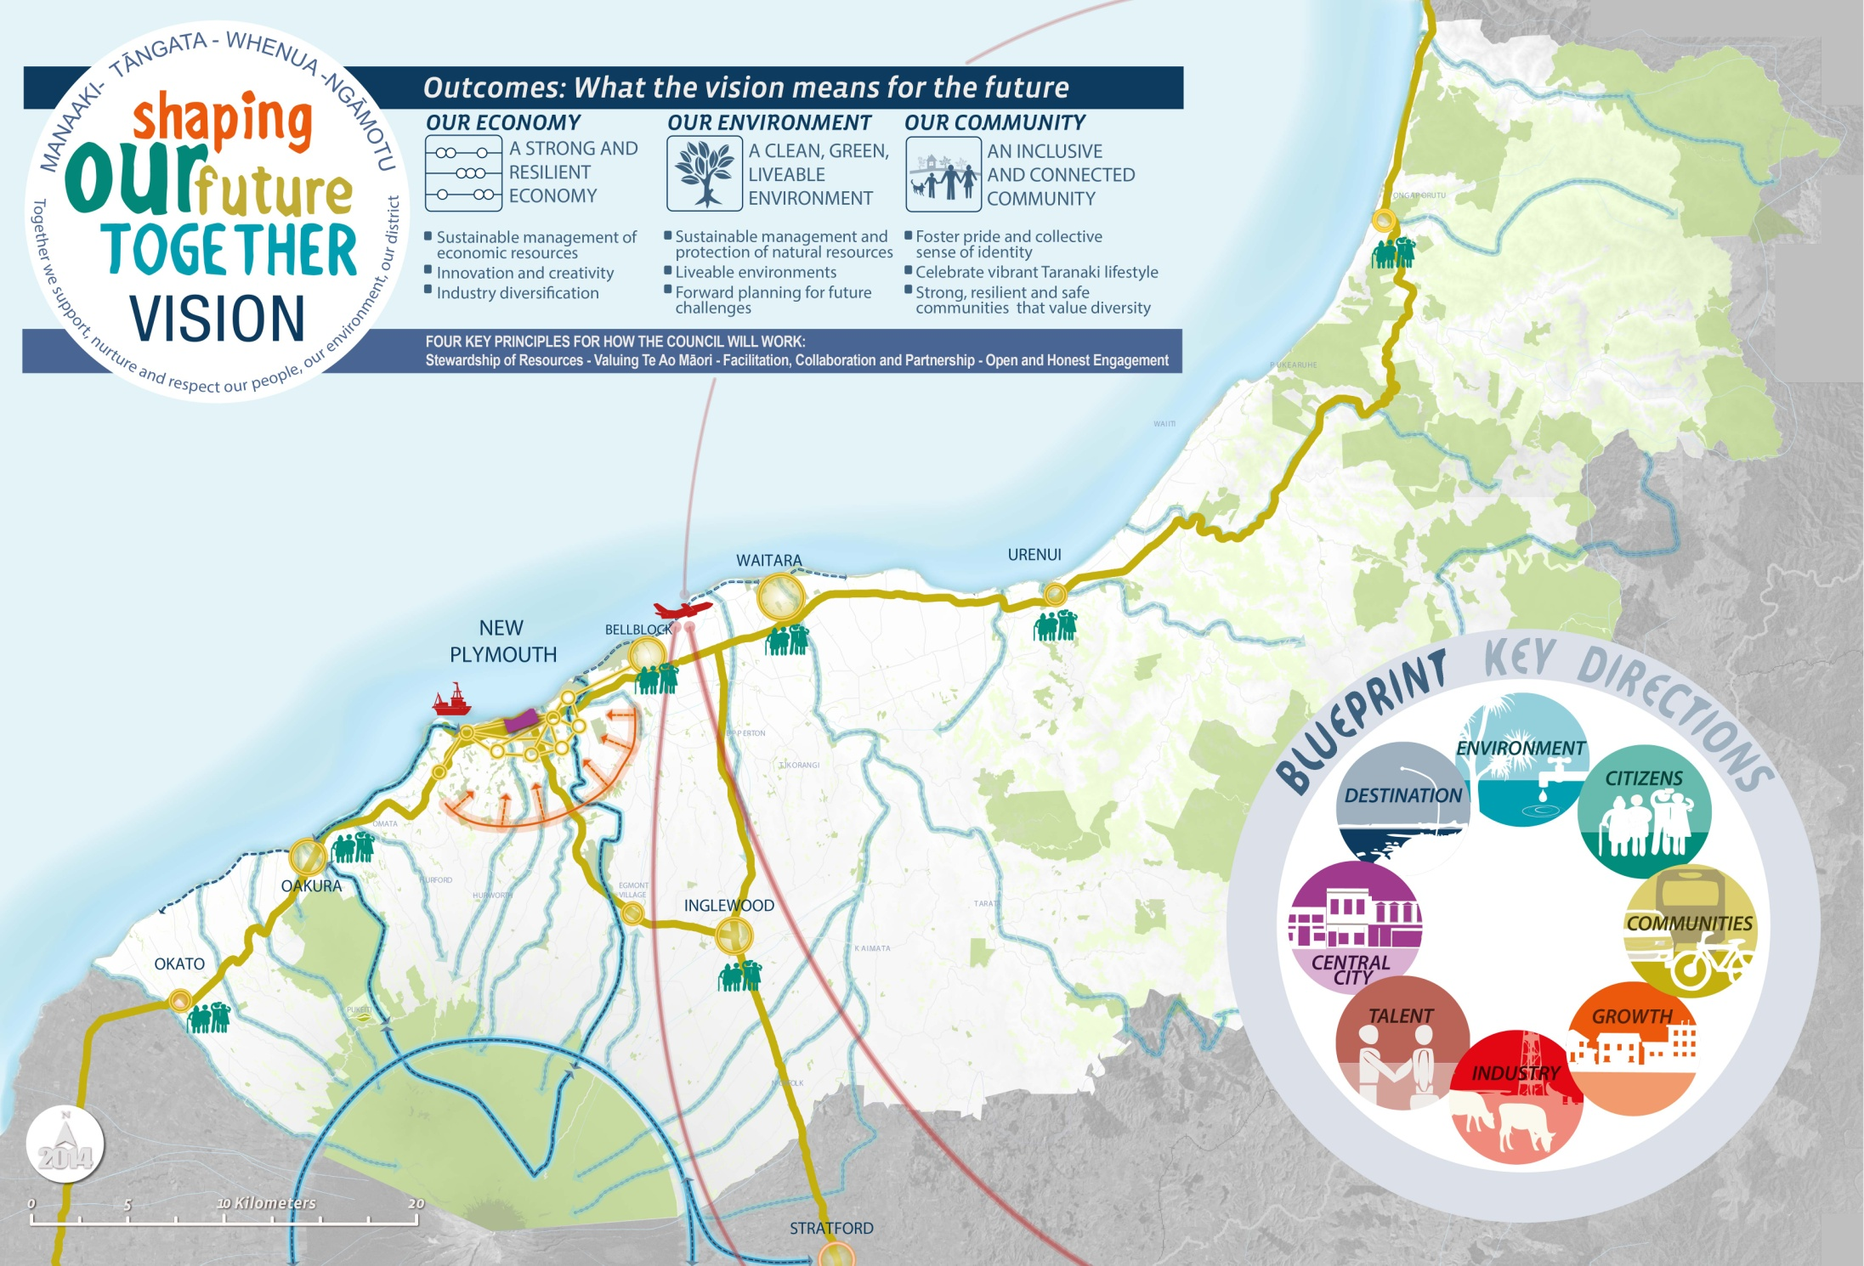
.
Notes:
Blueprint 8 key directions
Blueprint workstreams:
1: Telling the story – Internal messaging, making Blueprint part of out DNA
2: Keeping it local – Community plans
3: New Plymouth City - Activity Centres Review & strategic review of Council property in CBD – will look at opportunities for rationalisation and joint ventures, individual sites to be examined. Consultants : Property Economics ( Tim Heath )
4: District Plan review - 40% of key initiatives are District Plan related
5: Long-term planning – Blueprint lens for aligning strategies, policies and by laws, incl community board plans into LTP, Infrastructure Strategy. Geo-coding of projects.

Slide 4
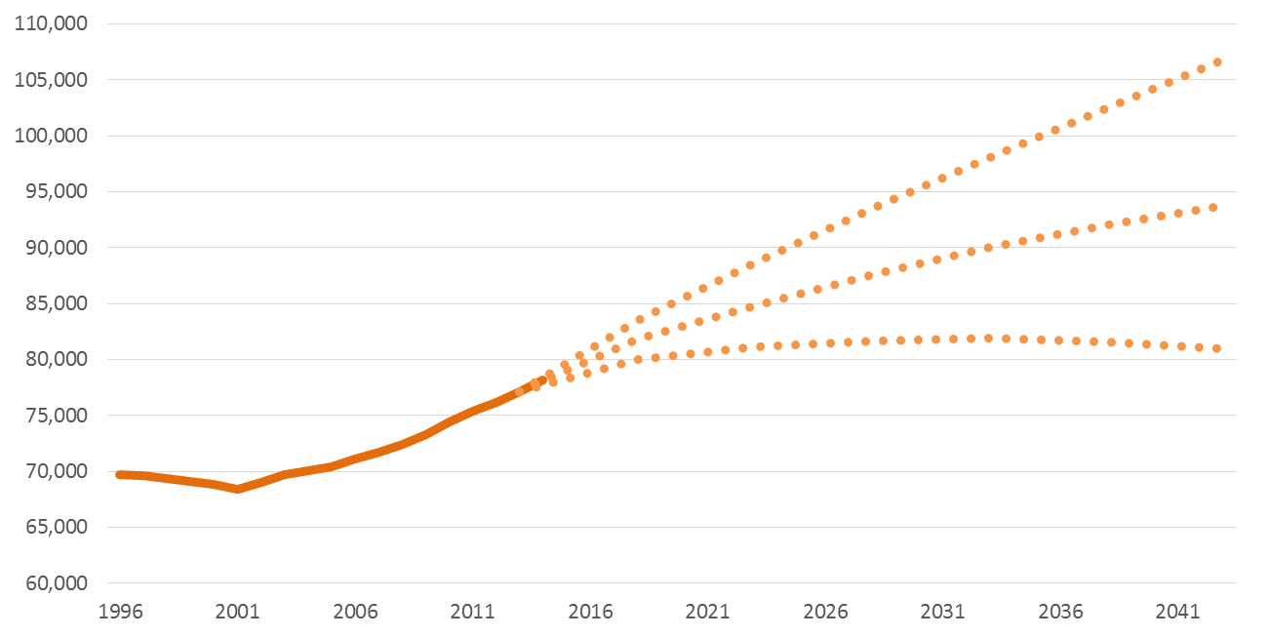
The Stats – Our District
79,000 people living in New Plymouth District
Population is projected to grow by 1000 people per year
This equates to 350 additional houses per year for the next 10 years
Notes:
Source Statistics NZ
Population has been growing since 2001.
Currently there is not a sufficient supply of residential zoned land to meet our population growth

Slide 5
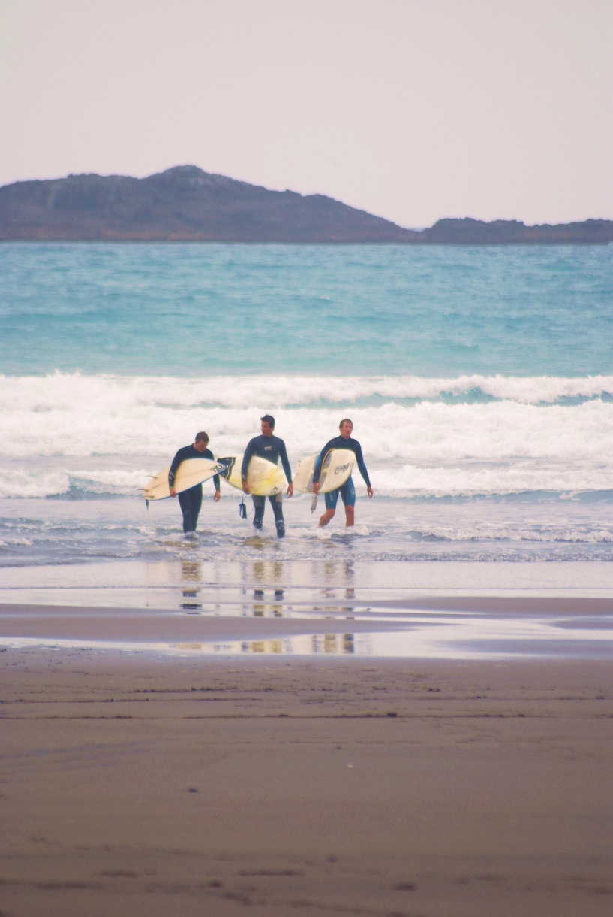
The Stats – Our District
25% of household incomes earning $100,000 or more per annum (national average 28%)
A high number of retirees. 25% of the working age population earning an income from superannuation
Cheaper place to live. Only 17% of renters pay more that $350 a week rent (compared to 41% nationally)
Notes:
Source: Tim Heath Property Economics
Are housing choices meeting the needs of our communities? Single people, Smaller households, large households, high income earners, disabled, people looking to downsize?

Slide 6
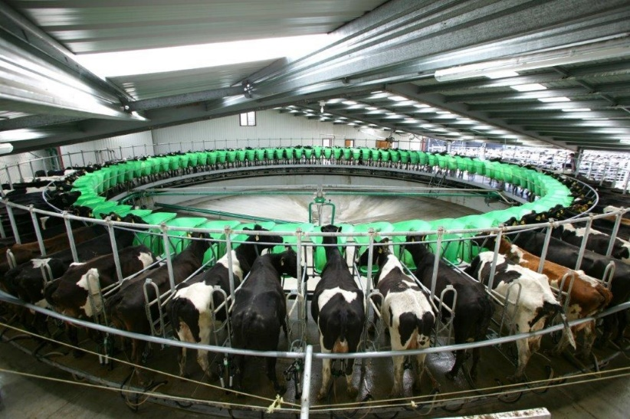
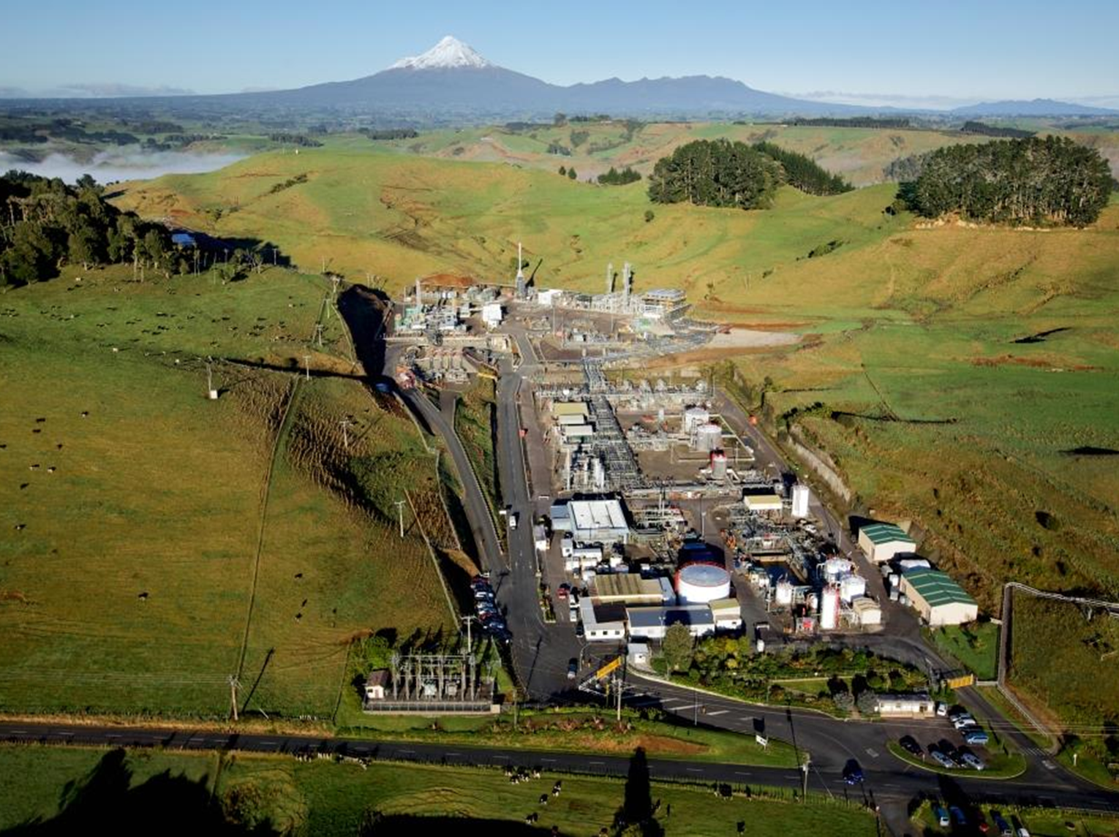
The Stats – Our District
The industrial sector accounts for 30% of total employment
Commercial sector accounts for 23%
The oil and gas industry has seen almost 140% growth in employment from 2000-2015. Associated administration and safety sectors continue to experience rapid growth
Notes:
Source: Tim Heath Property Economics
Industry is vital to our social and economic wellbeing.
Council needs to ensure there is certainty for industry (e.g. get the green flag if parameters are met with no expectation of third party rights).
Council needs to signal the outcomes it expects so that industry can respond and provide for them.

Slide 7
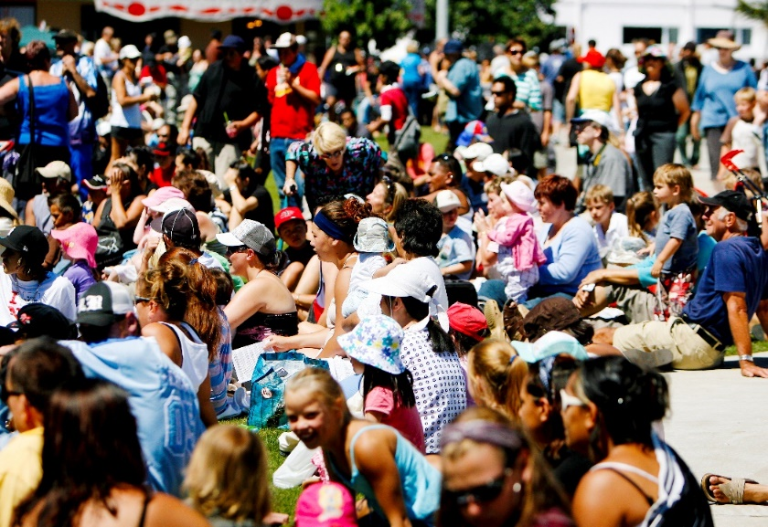
The Stats Where do we spend our money?
$554.9m spent in Taranaki during half year to June 2016
Local Customers - 87% of spending in the Taranaki region is from Taranaki cardholders
75.5% of that spending spent within New Plymouth District
11% were from outside of the District (mostly Stratford and SouthTaranaki)
Key peaks in spending: New Year, Waitangi Weekend, Easter and ANZAC weekend
Department stores attract the highest level of retail inflow into the district
6-8% retail spend is online: Biggest spend on department/variety/other (23.7%)
New Plymouth Waitangi weekend
Notes:
Source Venture Taranaki
Almost all of Taranaki wages are spent in our region. New Plymouth takes the lion share of that $$.
January 2016 highest monthly retail spend
New Plymouth is able to defend its role and function better than other parts of provincial NZ because of its greater distance to competing destinations
Why is spending up? Next slide

Slide 8
The Stats Talented work force and a destination
We have specialised skill sets that support our industry and strengthen our economy
Our lifestyle continues to attract businesses and talent
We have world class attractions that are unique to Taranaki
Notes:
We have points of difference from the rest of provincial NZ.

Slide 9
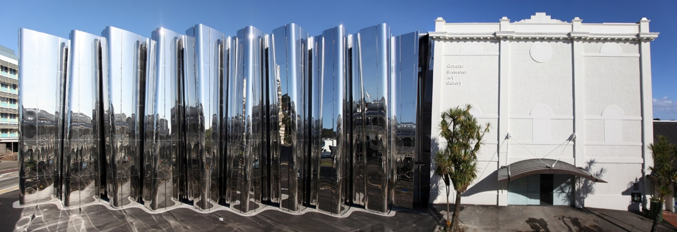
The Stats We are a destination
17.7% growth in visitor numbers in Taranaki (national average 6.9%)
Guest nights went up 17.7%
International nights were up 36.4%
Average length of stay rose to 2.08 nights
Notes:
Visitor numbers exceeded expectations, 151,000 people though including 24% of people being repeat visitors.
Retail sales exceeding expectations at more than double the expected level.
What they are saying? New Plymouth is “edgy”. This is our competitive edge over the rest of provincial NZ.
How do we capitalise on this?
Active Donations Strategy - all visitors to the Lye Centre be encouraged to make a donation via dedicated eftpos terminal
Building on our existing attractions and events (next slide)

Slide 10
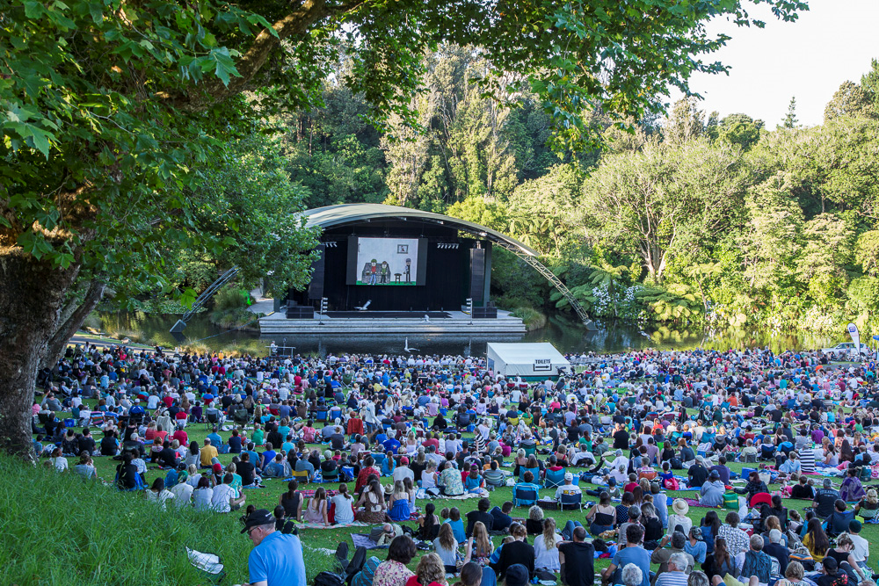
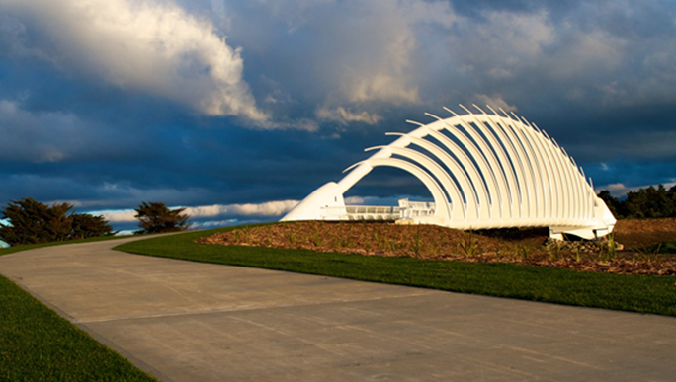
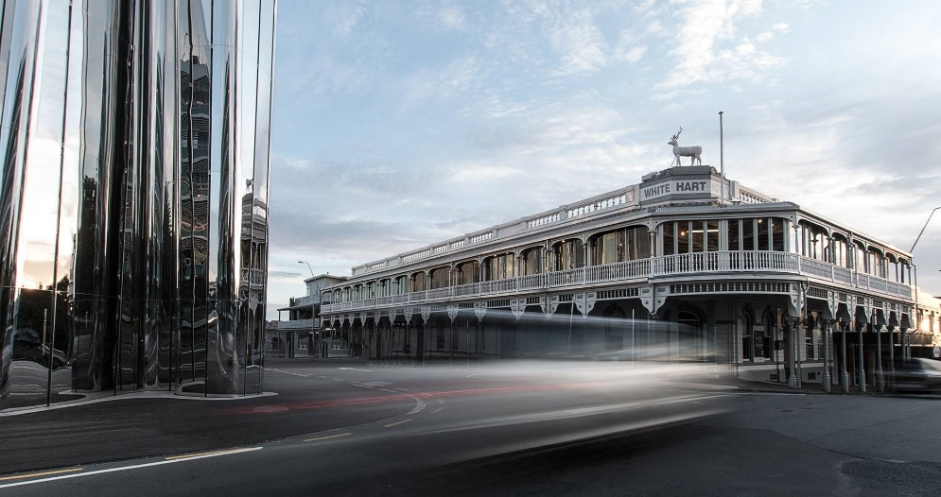
The Stats So much to do
Plus more in the pipeline……
Notes:
Not just a beautiful mountain…
Visitors are surprised how much there is to do here
Coastal walkway
Windwand
Womad
Arts and Culture
Festival of Lights
Americania
Yarrows Stadium
Opera House
Surf and skating scene
Cafes and restaurants

Slide 11
BUT (there is always a but)…....
Retail and commercial activity is spreading away from CBD
This is undermining public and private investment in the CBD
It is also compromising the role and function of other urban land e.g. residential and industrial land
We are not adequately addressing residential land supply to meet our growth projections
We are not seeing a range of housing choices being presented to the market
Natural coastal values need to be better managed
We are not growing in a strategically planned way
The current District Plan is very flexible and we are getting unforeseen outcomes
Our Response
Notes:
Our District Plan was written in the 1990s and is now out of date.
RETAIL:
19% retail leakage. Retail and commercial activity bleeding away from CBD spreading to CBD fringe and out of commercial areas altogether.
The CBD core is currently experiencing negative growth in retail and commercial activity, including employment loss.
This trend needs to be reversed. Lowers NP competitiveness, the communities economic wellbeing and social amenity and creates uncertainty and direction for investment.
CBD has an excess of retail space.We have a gap in Clothing, Footwear and soft goods offer. Market opportunities exist for improved provision and performance – needs to meet todays modern market requirements.
Focus needs to be on quality retail stores, retail environments and retail experiences.
COMMERICAL:
An additional 10ha “at grade” of commercial office land is required to meet forecast demand. The most economically efficient and productive use of land resource is to accommodate growth of 2-3 storey developments 2-3 Ha. This can be comfortably accommodated in the existing CBD areas.
RESIDENTIAL:
Higher density residential development to help with economic and social rejuvenation. Plus different type of houses to meet changing demographics
We are not broken (50% of the total stores in the district are contained in the CBD) but we need a more directive District Plan to help support our CBD, which in turn will improves community economic wellbeing and social amenity.

Slide 12
Enabling while protecting key values
Provide for social, environmental, cultural and economic sustainable growth outcomes
Regionally relevant
Provide certainty and direction for investment
Streamlined and easy to use
On-line functionality
Notes:
District Plan Review which will result in a new District Plan.

Slide 13
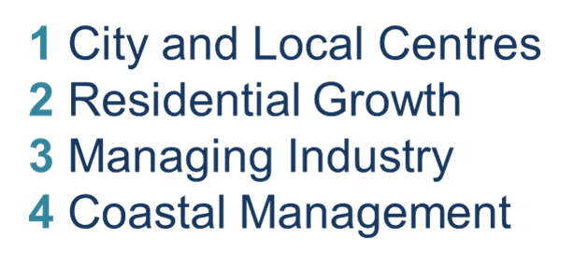
Notes:
We have focused on 4 top issues

Slide 14
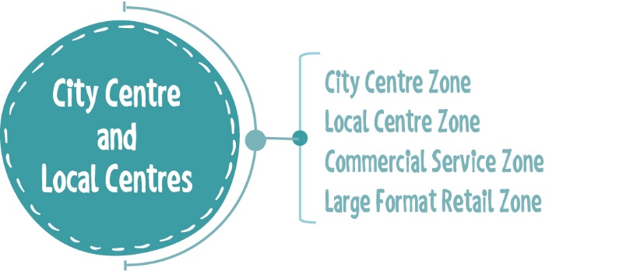
City and Local Centres
Notes:
4 new commercial zones that form a centres hierarchy. Focus on the CBD and local centres to be the primary activity hubs.

Slide 15
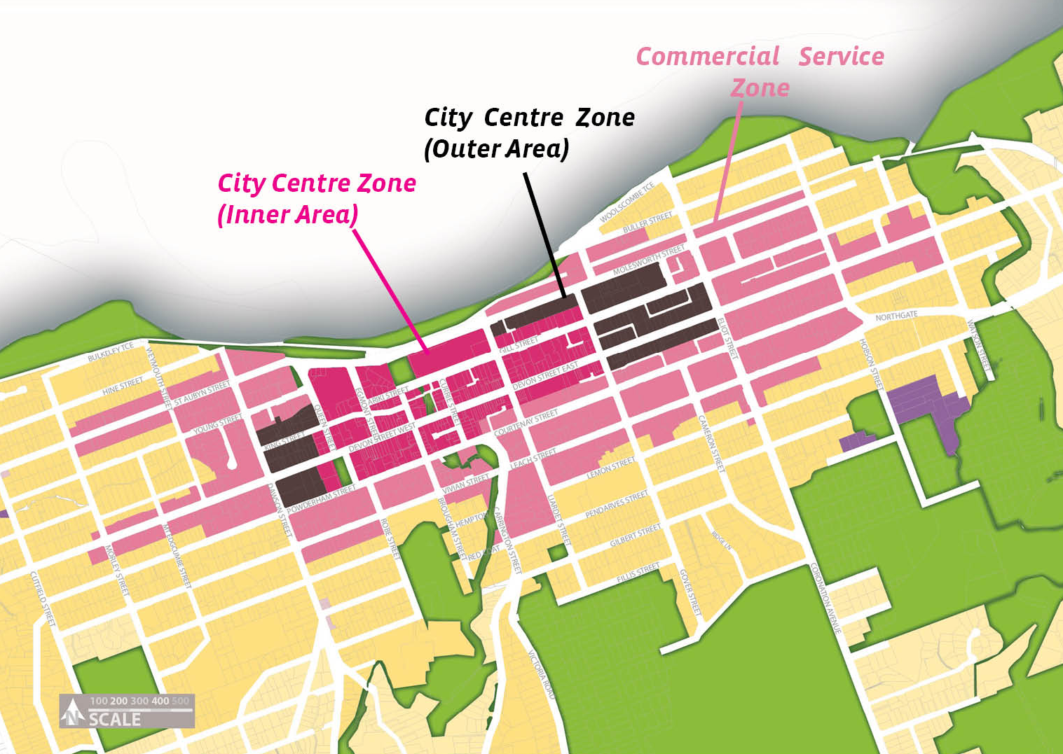
City and Local Centres
Issue | Draft Response | Draft Framework
The City Centre is using more land – stretching. | Focus retail and commercial activities into the central city through more specific zoning. | Identify the city centre zone and divide into the inner and outer areas
The City Centre is using more land – stretching.
Focus retail and commercial activities into the central city through more specific zoning.
Identify the city centre zone and divide into the inner and outer areas.
Notes:
The Rubber band - the CBD is stretching causing the disbursement of retail and office activities on to the one-way systems. Not only are businesses difficult to access (other than by car), it is undermining the role and function of the City Centre.
Answer – 1) Manage “out of zone” activities 2) tighten the city centre zone boundaries 3) divide city centre into the inner and outer areas.
The Inner Area caters for all retail, commercial, office and entertainment and residential uses and an Outer Area focuses on mixed use but also encourages transformation over time to more residential living.
Also exploring whether we need to develop an arts and culture precinct

Slide 16
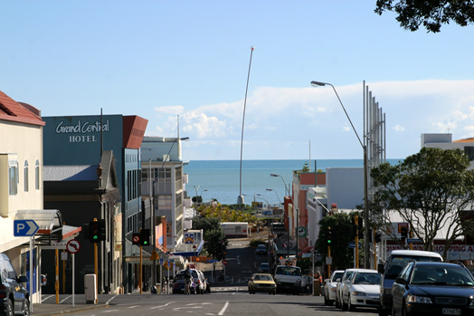
Quality Design
Issue | Draft Response | Framework
There is a mixed quality of buildings and public spaces, in the central city and centres | Better manage the design of new buildings with a focus on the streetscape. | The Inner City and local centres zones will be pedestrian focused.
Council leading by example
Notes:
Urban Design Basics
Pedestrian friendly, active edges, emphasizing prominent corners, considered signage,

Slide 17
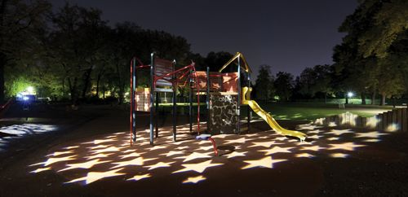
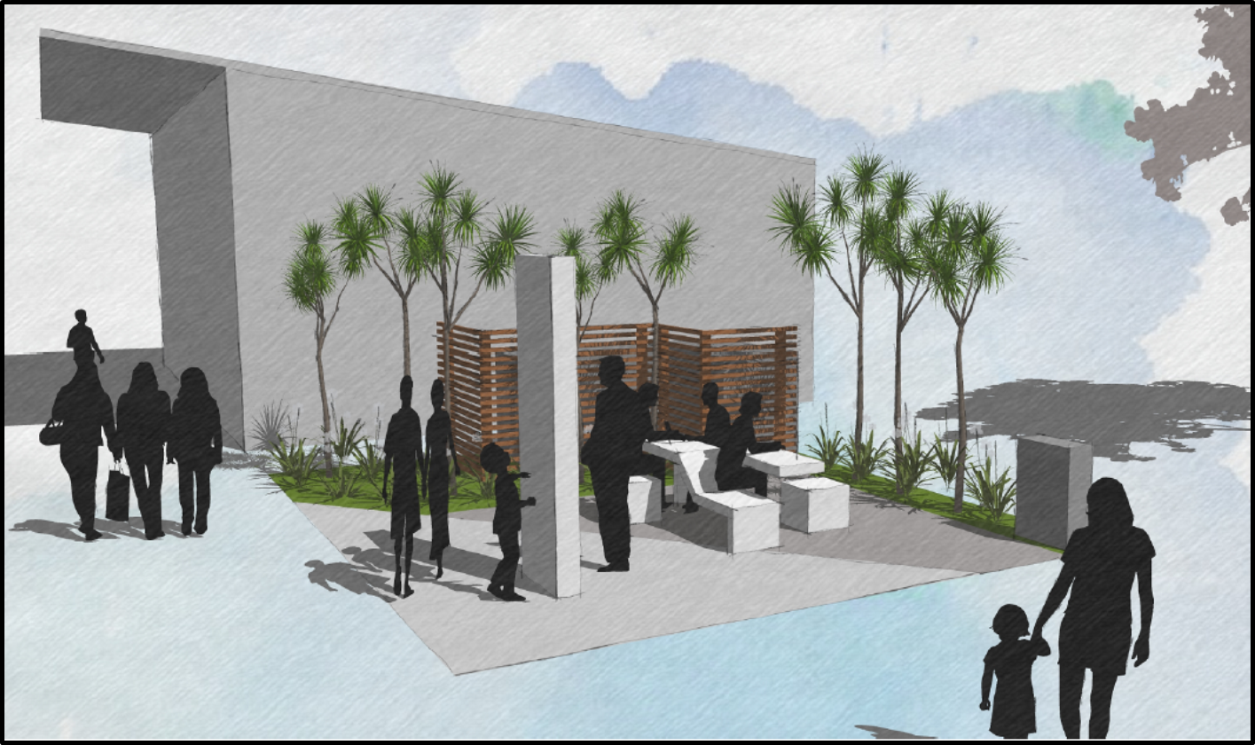
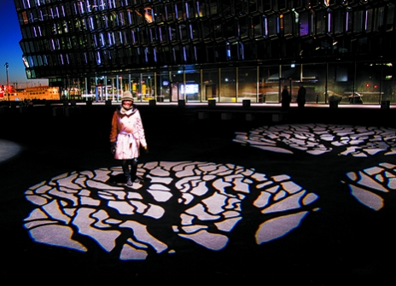
Project New Plymouth City
Light up the Laneways
Green the City
Notes:
Using Blueprint initiatives, Council can also lead the way in promoting quality urban design and build momentum in drawing retail and commercial activities back into the CBD.
Light up the laneways: A project to increase safety and interest in the laneways connecting publics spaces around the Huatoki Plaza

Slide 18
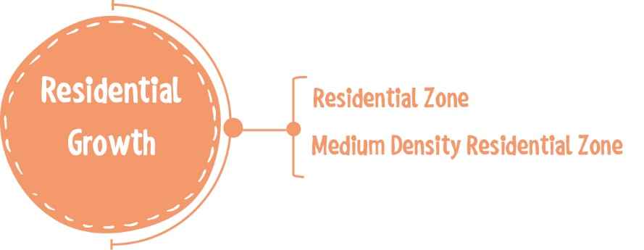
Residential Growth

Slide 19
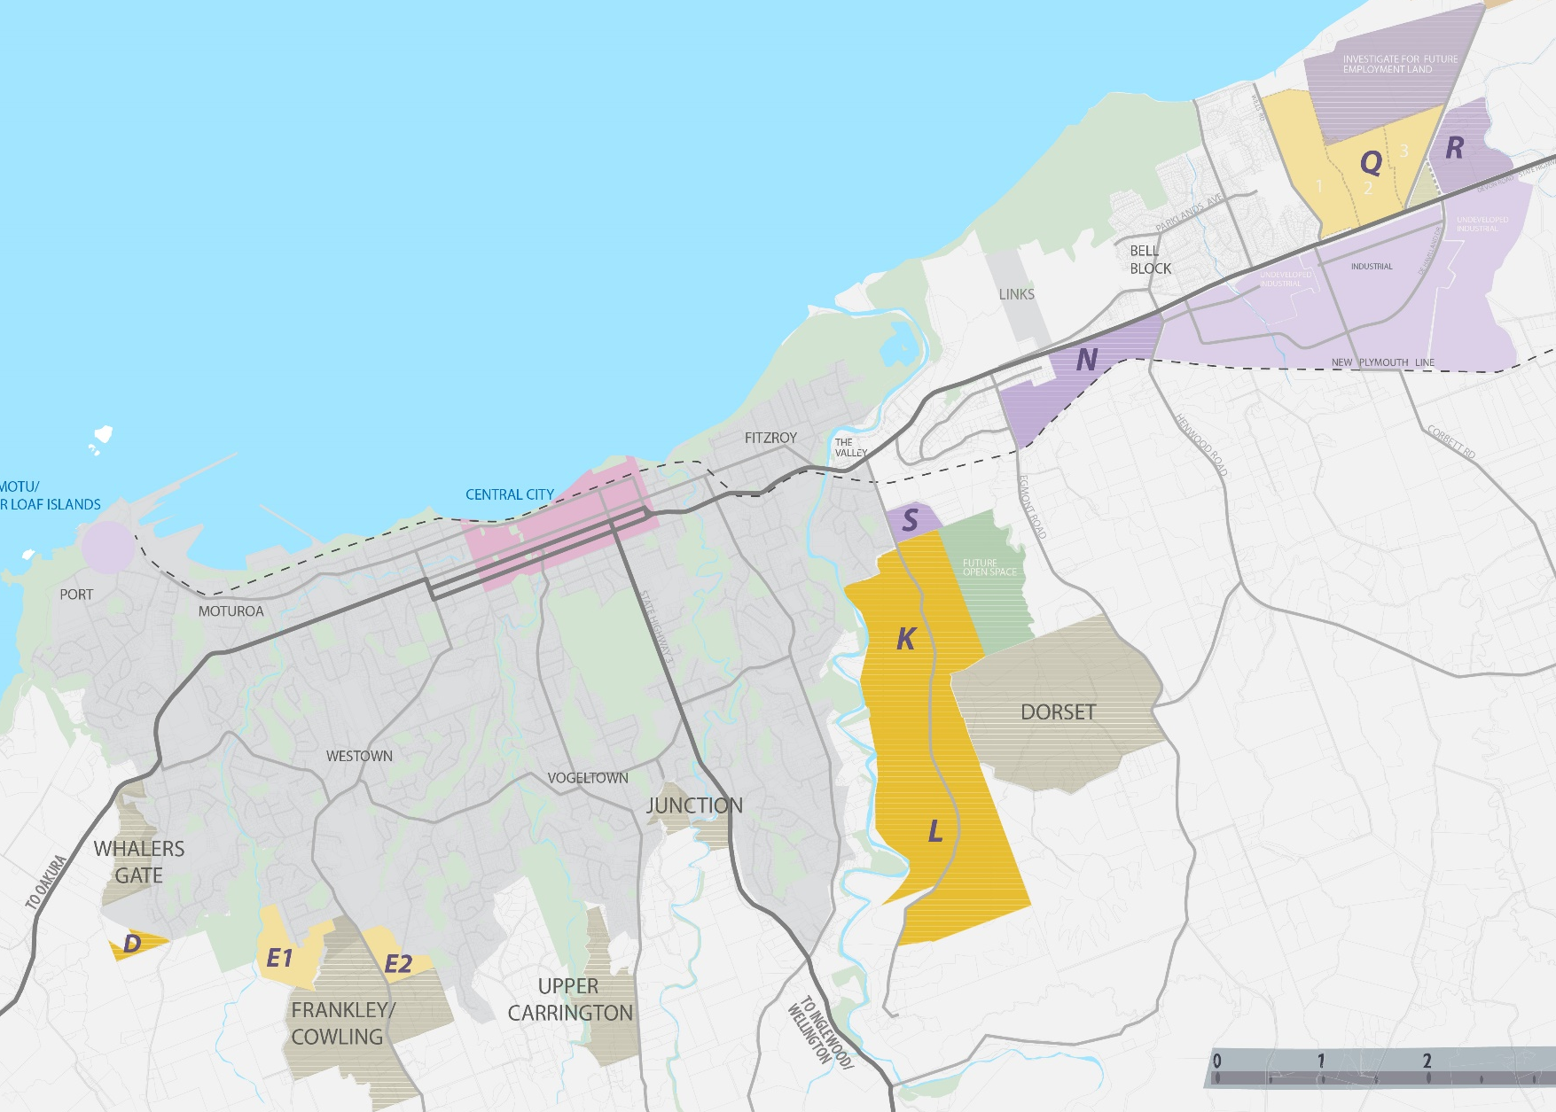
Residential Growth
Issue | Draft Responses | Framework
Insufficient supply of residential zoned land to meet our growth projections | Re-zone land to meet the short, medium and long term needs while ensuring a compact urban environment. | Rezone additional land. Include a Future Urban Growth Overlay that requires structure plans.
Notes:
Forecast projections of 1000 people per year, and 350 additional houses.
Need to provide a sufficient supply of land for residential and business growth
Need to ensure that it occurs in a cohesive, compact and structured way within identified areas

Slide 20
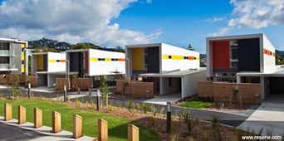
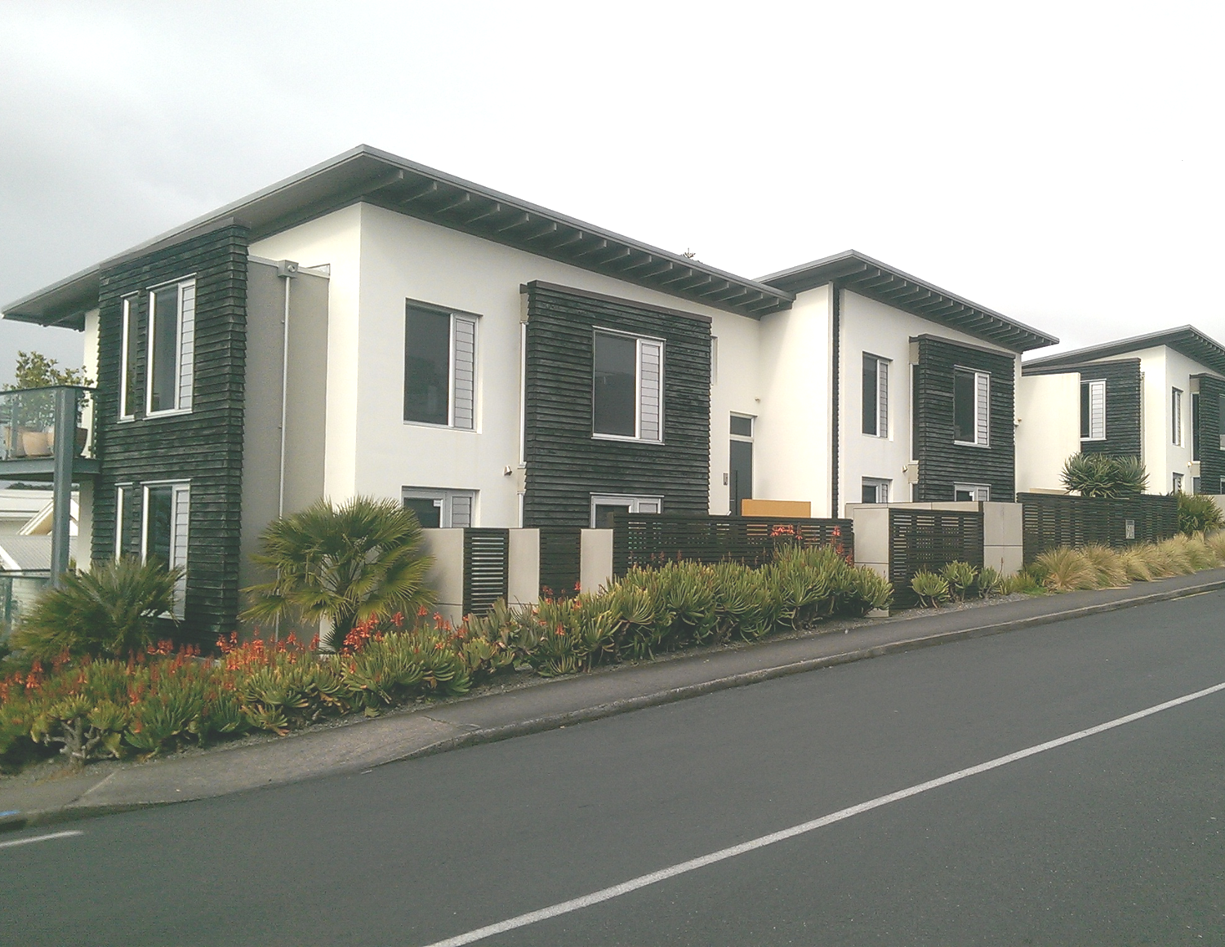
Residential Growth
Issue | Draft Responses | Framework
A range of housing choices are not being provided in the District limiting options for current and future landowners. | Provide more options for residential growth that includes intensification. | Reduce to two residential zones General Residential: This is where most people will live in our suburban areas in the district Medium Density Residential: around city centres, transport nodes (multi-unit), within 10 mins of an open space
Notes:
Medium density photos: Regent Park Wellington & Buller St NP

Slide 21
Medium Density Zone Example
Notes:
We will be testing possible areas with the community.

Slide 22
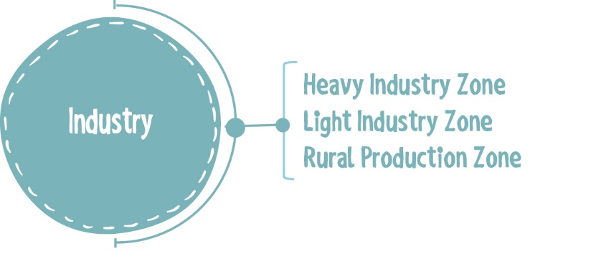
Managing Industry

Slide 23
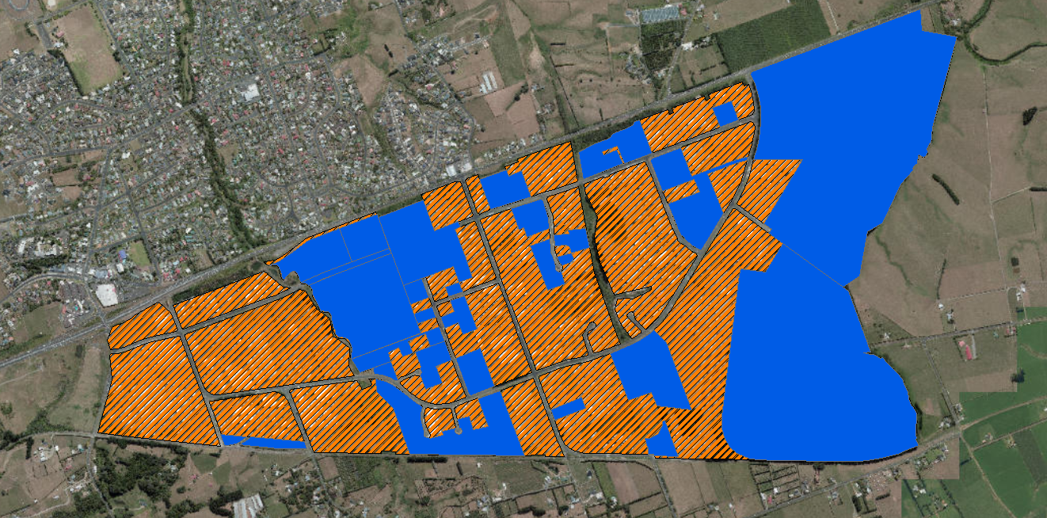
Efficient Use of Land
Issues | Response | Framework
Non-industrial activities are establishing in the industrial zones, reducing land options for industry activities | Manage “out of zone” activities by requiring resource consent to consider the impact on the ability of industrial activities to operate. | Simplified zoning framework from 6 zones to 3.
Notes:
.

Slide 24
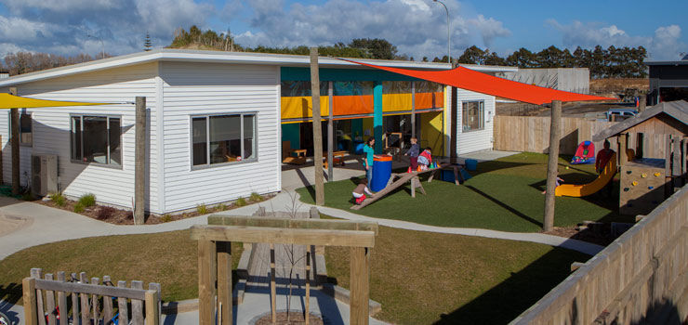
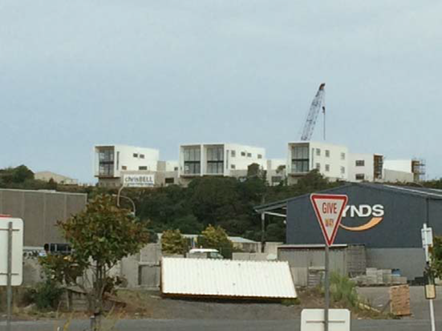
Managing Conflict
Issues | Response | Framework
There is often conflict between industry and sensitive activities. | Manage sensitive activities from locating next to industry and in industry zones | Activity listing in industry zones Introduce separation distances for industry and sensitive activities.
Notes:
.

Slide 25
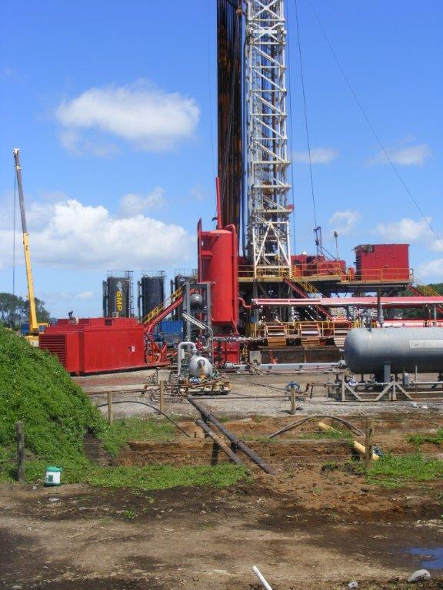
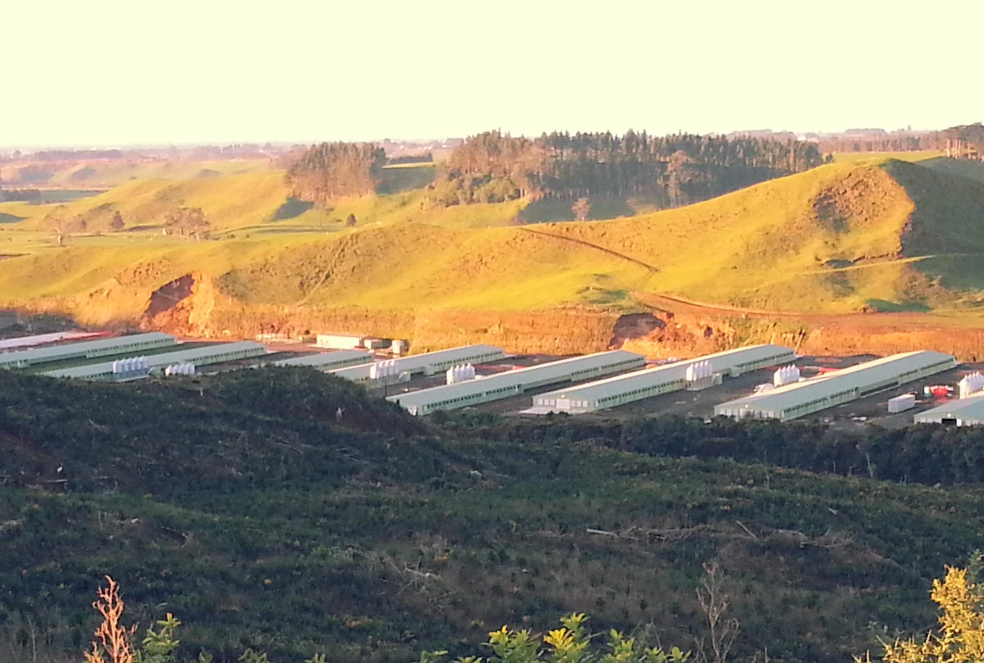
Rural Industry
Issues | Response | Framework
Rural industry can find it difficult to operate with certainty | Better manage the effects by requiring consent as a discretionary activity Place greater emphasis on the strategic importance of industry in objectives and policies | Introduction of major facilities zone. Separate section on oil and gas (energy).
Notes:
Major facilities zone = Port Taranaki, Methanex, New Plymouth Airport etc
Specific Oil and Gas provisions (Energy chapter) that align with the focus taken by STDC – Regional streamlining.
More certainty to the community regarding larger scale activities and to industry. Focus on appropriate site selection.
Signal appropriate location on major arterials, avoiding sensitive activities, consider visual impacts on rural character.
The outcome would mean more certainty for industry to establish small scale activities (eg; get the green flag if parameters are met with no expectation of third party rights) and a more involved consent process for larger scale rural industry. Better signals are needed in the Plan on the outcomes it expects so that industry can respond and provide for them.

Slide 26
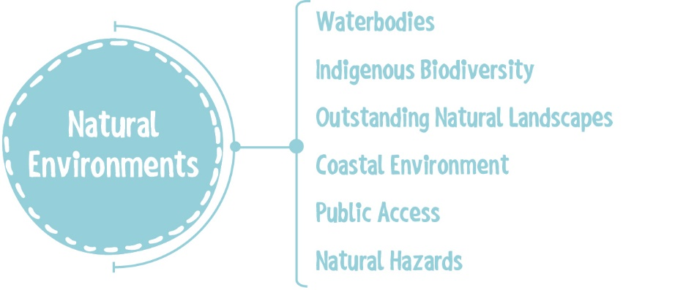
Coastal Environment
Notes:
Overlay – reliance on the district plan

Slide 27
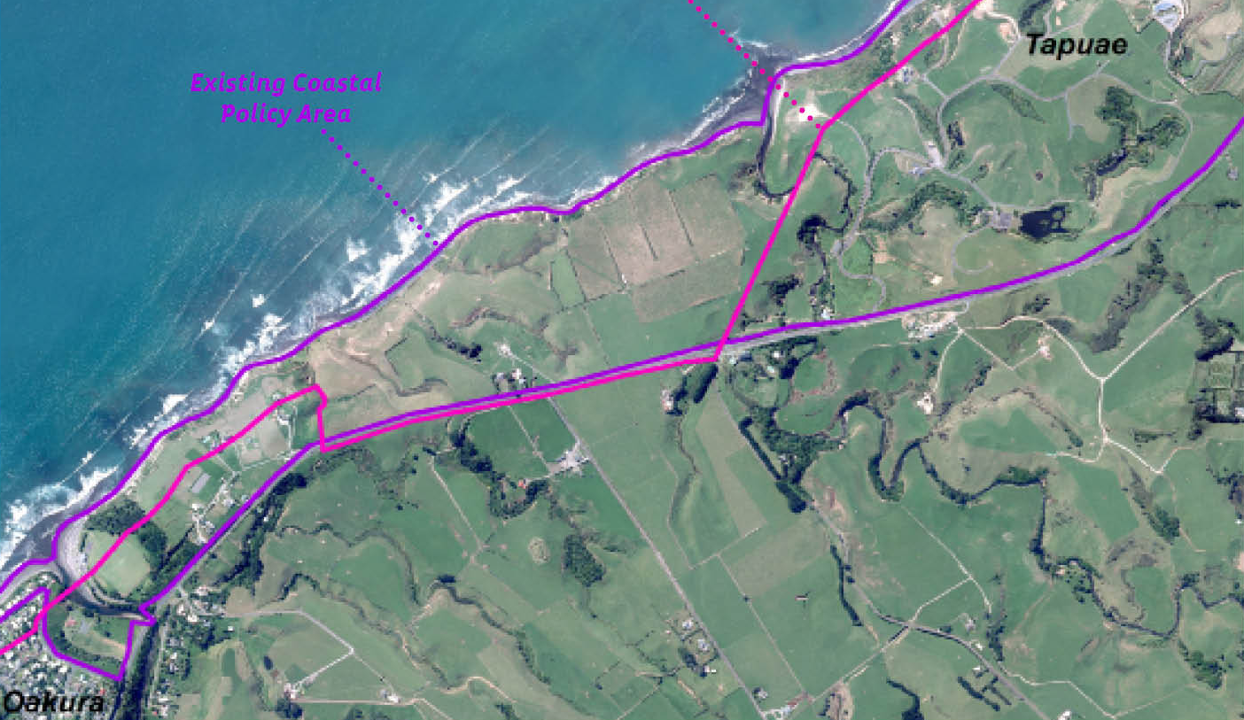
Natural Character - Coast
Issues | Draft Response | Draft Framework
Legislative requirements to identify and manage coast The coast is losing natural character values | Better manage the coastal environment in a holistic way including natural character & coastal hazards Introduce a new coastal overlay that identifies important values in the coastal environment. | Include an overlay and related provisions to manage growth and coastal hazards.
Notes:
This approach aligns with our neighbours at STDC

Slide 28
Planning for the future
Current District Plan
Ad hoc
Flexible
Certainty
Strategic
Outcome focused
Notes:
40% of Blueprint key directions are related to the DP review. Regulatory responses to work us towards our visions
To summarise the focus of the Draft Plan is on:
Rural Industry, particularly oil and gas;
Coastal development;
Moving from effects based and out of zone activities;
Managing growth and where we want to rezone land for urban expansion;
Providing for housing choice and medium density zone;

Slide 29
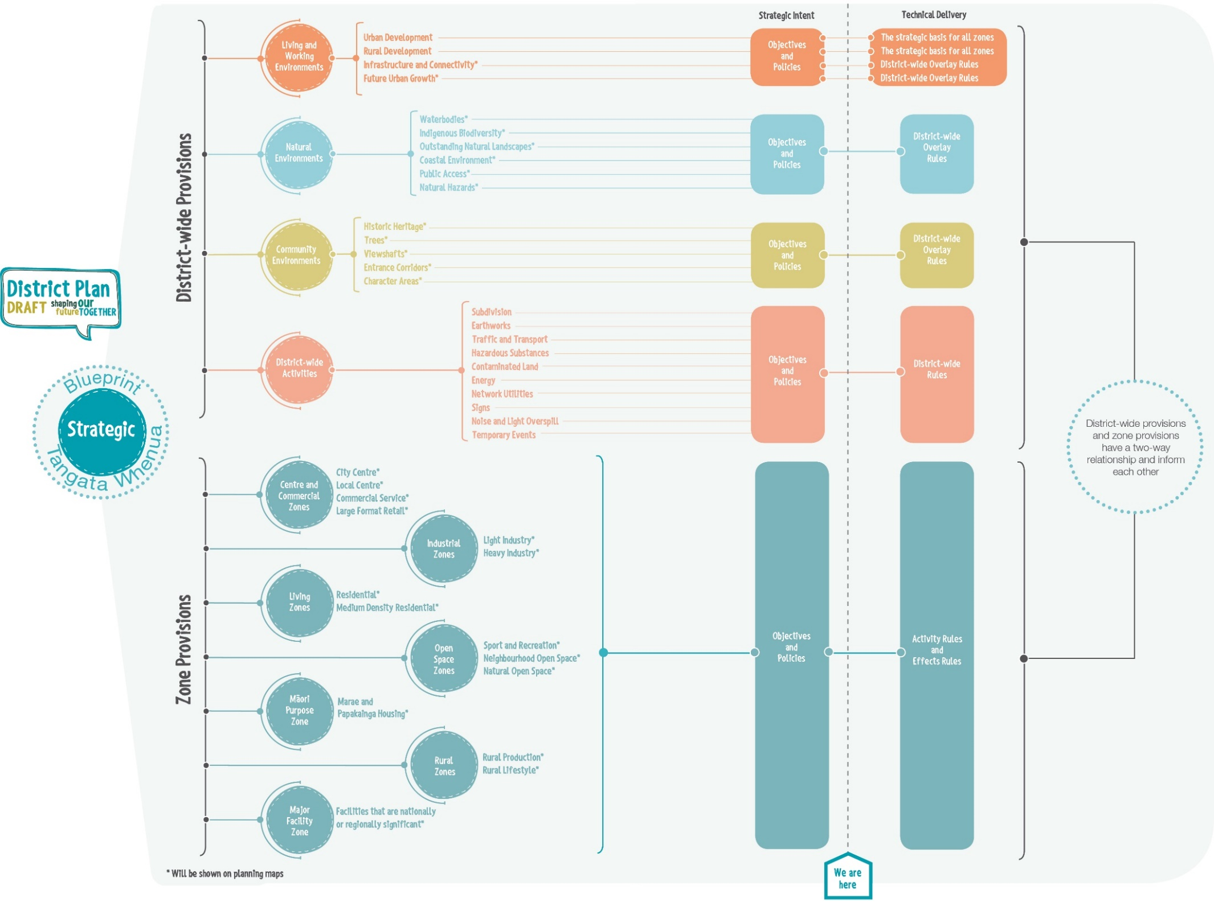
We are here

Slide 30
Release draft District Plan for public comment
Notes:
Draft District Plan allows us to iron out and understand issues at the outset.
Consultation with stakeholders, Nga Kaitiaki, public awareness campaign, meetings with interested parties/groups, regular update reports to regulatory committee and Council Workshop programme

Slide 31
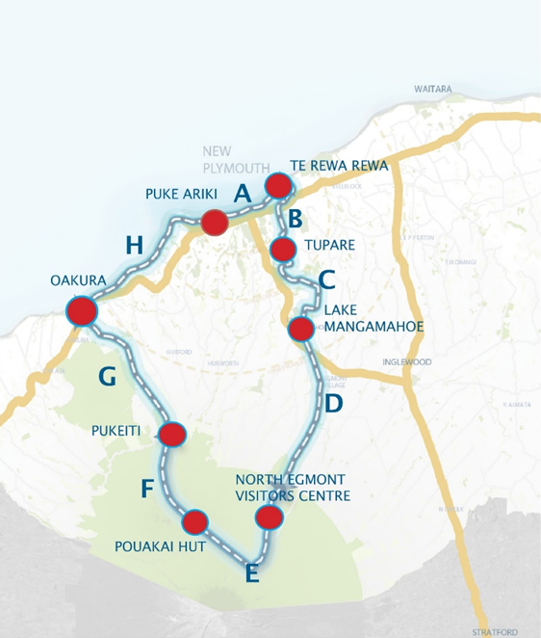
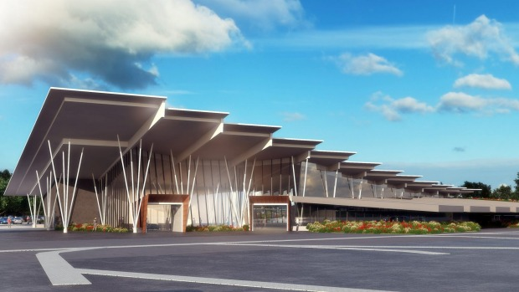
But not forgetting our edgy style…
Strengthening Taranaki as a national and international tourism destination
New Airport terminal building
Taranaki Traverse
Notes:
We need to keep our “Edgy” reputation fresh and continue to progress with innovative projects offering a unique welcome and experience.

Slide 32
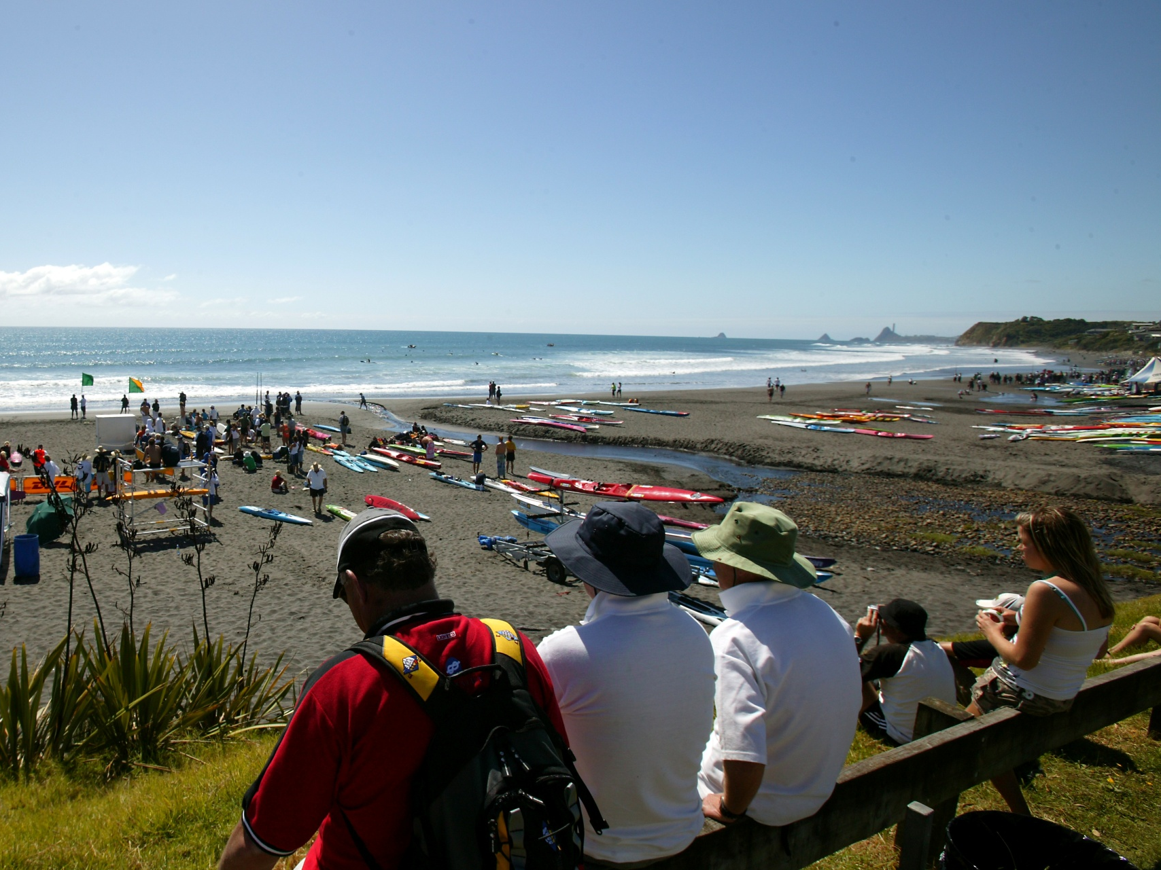
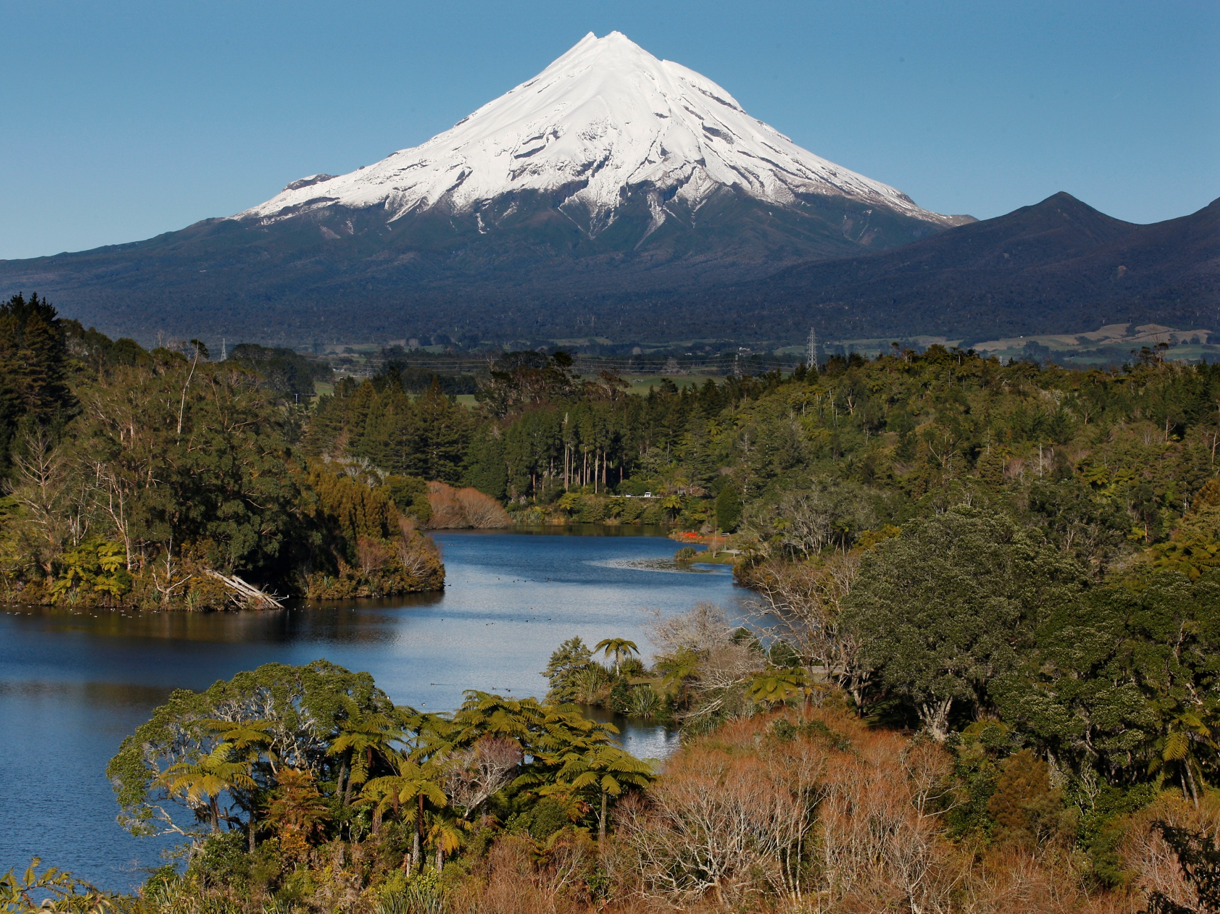
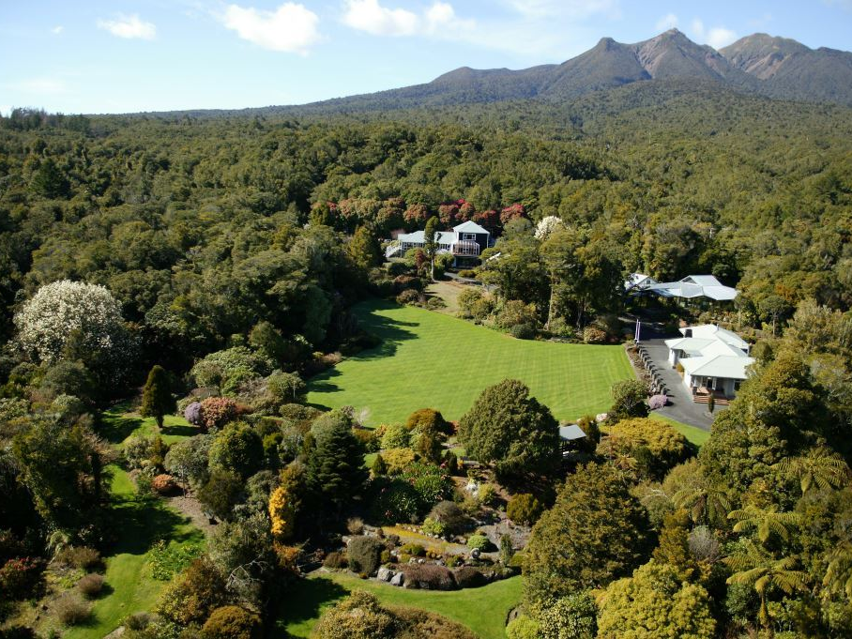
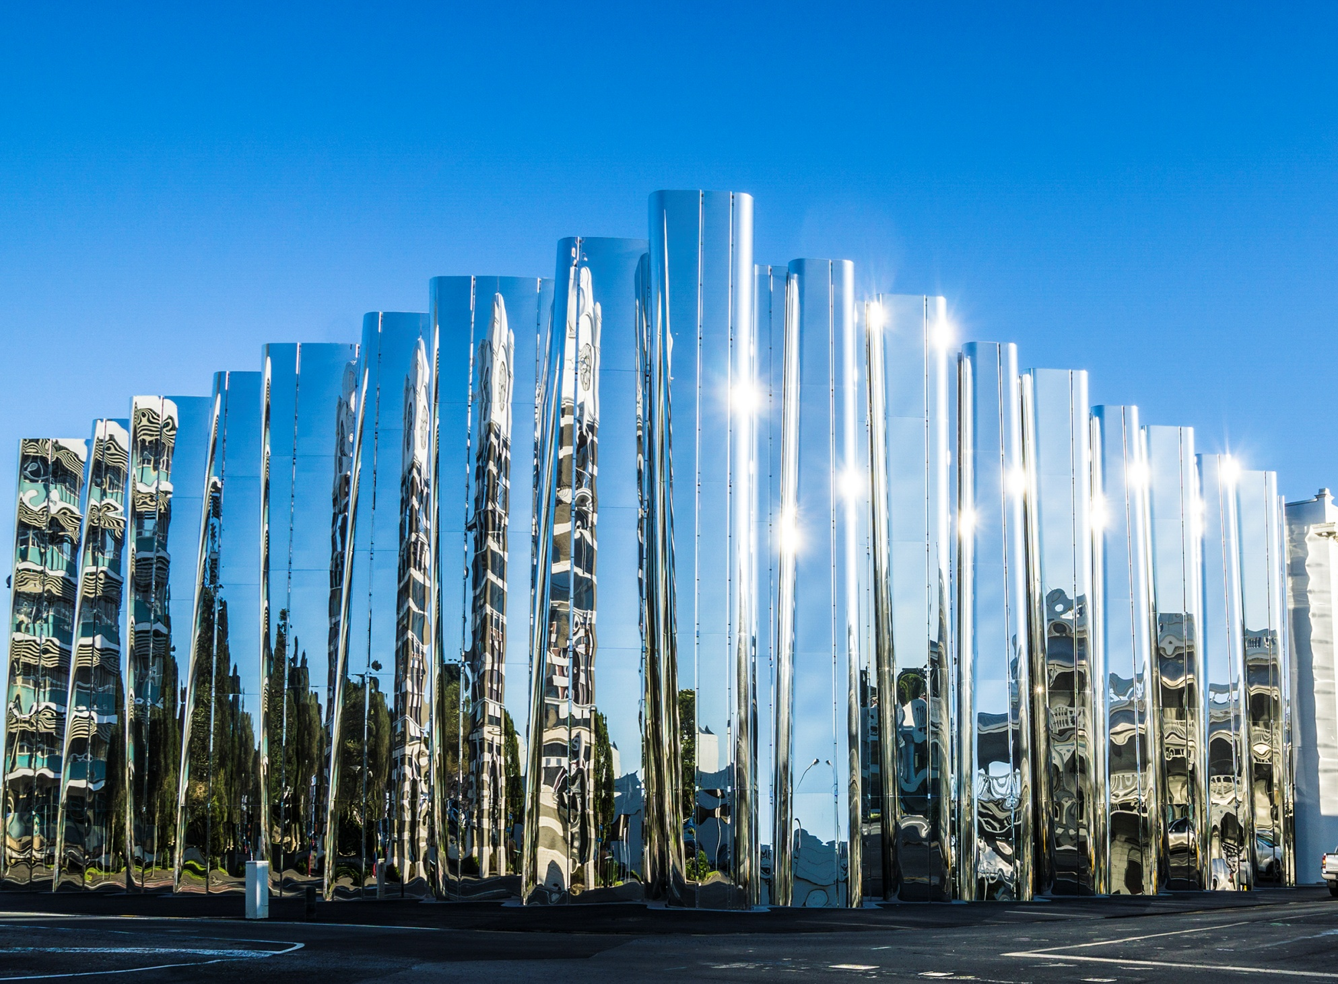
QUESTIONS
Taranaki Traverse

