Slide 1
Social Housing, NZ’s Tenure Revolution, Ageing Society and Property Investment
Kay Saville-Smith, Director CRESA
Property Investors Federation Conference
New Plymouth
16 October 2016

Slide 2
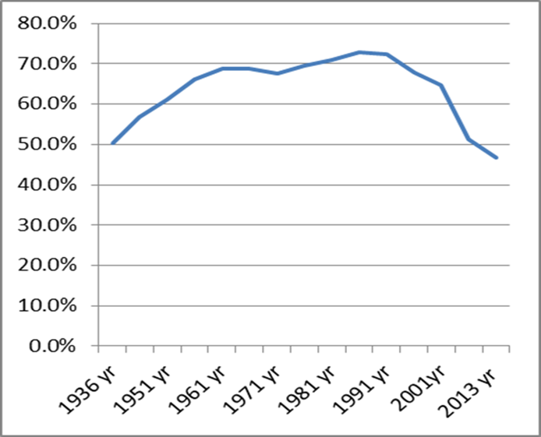

New Opportunities and Challenges
More people than ever before in rental
More stock in rental
Rental - no longer residual
Tenants of the future:
  More diverse
  Older – especially in provincial NZ
  Richer
  Poorer
O/Occupied Dwellings (excluding Family Trusts but including Retirement Villages)

Slide 3
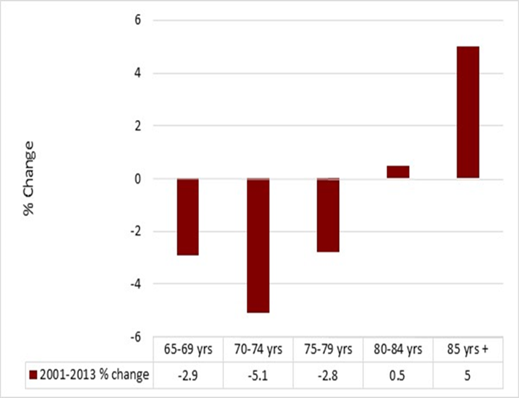
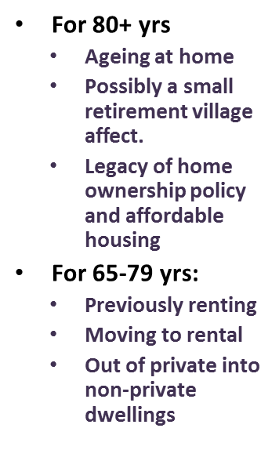
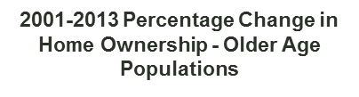
Diverse Older People – Different Trends But Heading for Rental

Slide 4
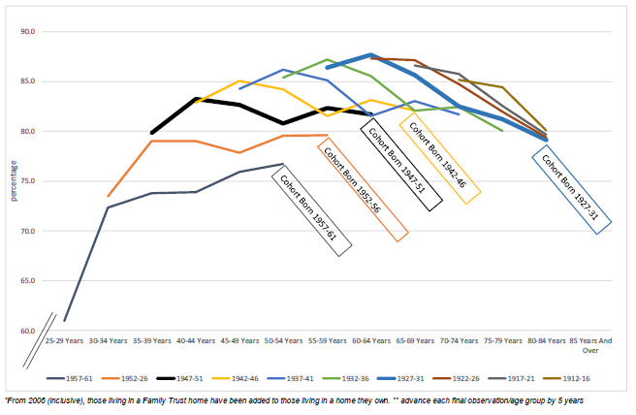

Slide 5
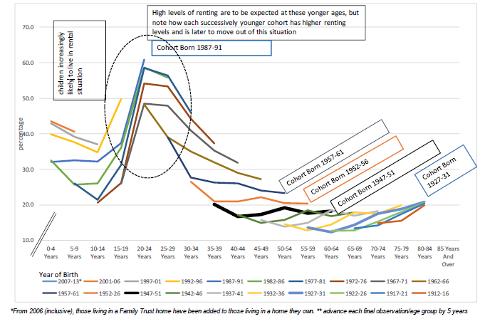

Slide 6
The Good, the Bad and the Ugly
Good:
  New demand
  Potential movement from home ownership to rental
  Provincial NZ is ripe for rental expansion
  Potential to service higher income groups
  Niche diversification
Bad:
  Margins are tight with high house prices
  Rent elasticities are limited – typically tenants will still be lower income
Ugly:
  Poor practice places investments at risk – moral hazard
    Tenant resistance – both among higher and lower income tenants
    Potential for increased regulation and policing of current regulatory instruments
  New issues around eviction and termination of tenancy
  Capital gain is not straightforward

Slide 7
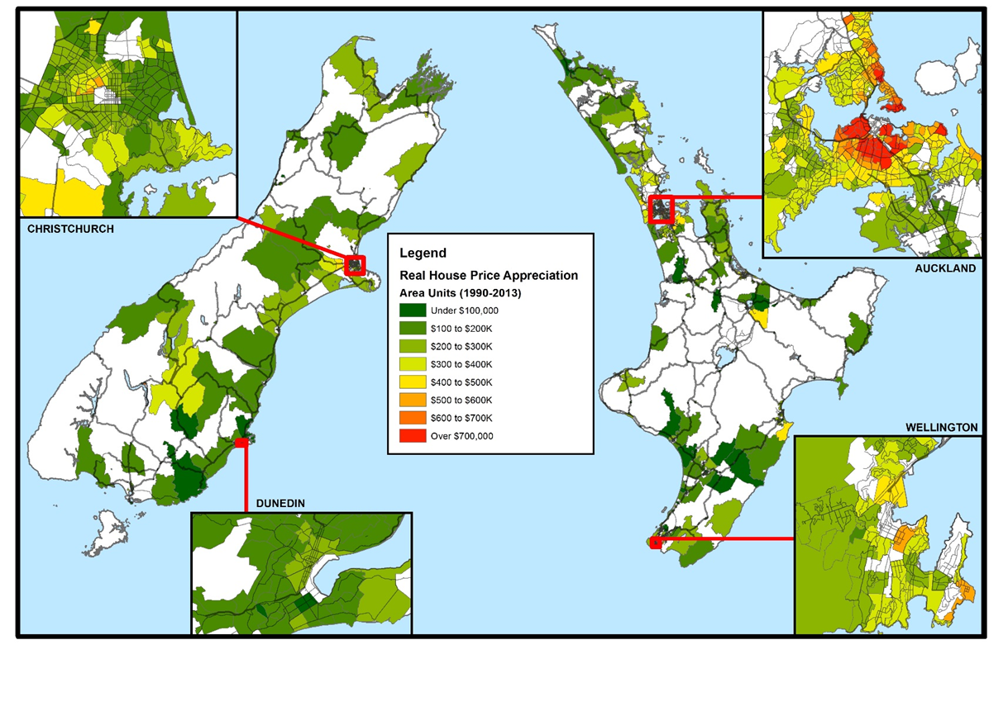

Real House Price Appreciation 1990-2013

Slide 8
It’s Going to Get Pretty Complex
Specialising
  Place
  People
  Stock
Making new alliances, networks, collaborations
  Service
  Financial

Slide 9
Specialising
Most landlords specialise in providing for and rental to low income tenants
Tenant population is ageing in place
More young people will be old tenants
Meeting the Challenge:
  Adapting tenancy management
  Fit for purpose stock
    Accessible housing
    Multi-generational/multi-family housing
    Location, location – reap the transport premium into rent
    High performance stock – reap the operating premium into rent
    Realise the downsizers – owner occupation to rent, smaller stock, retirement villages are not the only pathway for older people
  Places that give good returns
    Low entry pricing
    Maximising income certainty, reducing maintenance vs unaffordable rents
    Think provincial – ageing NZ, lower house prices

Slide 10
Renting to Older People
Future older tenants will be renters of the past
Some will be downsizers
  ‘Shock survivors’
  Equity release
Equity releasers:
  Some attractive to RVs – for LTOs and as Renters
  But not all older people are not attractive RVs
  Renting is an alternative - current equity release low – due to capital costs of re-purchase or LTO
    11% of older movers from owned house to owned house releasing equity generate $130/wk at 3% interest
    22% of movers to RVs releasing equity generate $130/wk at 3% interest
Older people need fit-for-purpose dwellings and tenancies
  Size counts
  Accessibility and performance
  Tenure security
  Responding to changes in physical and cognitive capacity

Slide 11
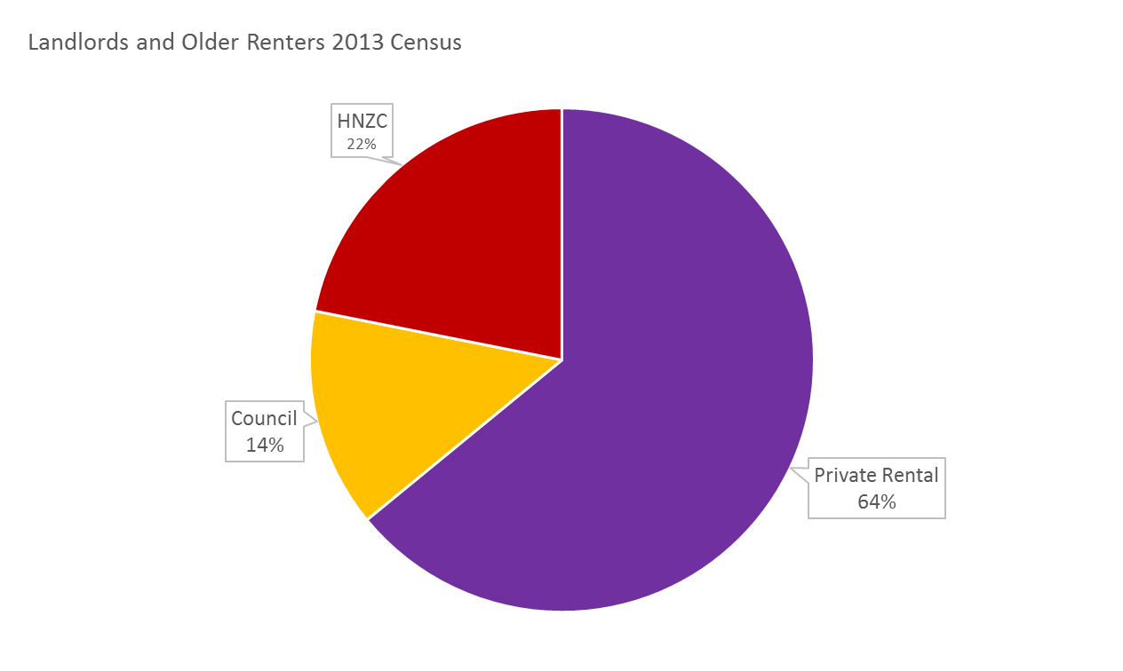
Renting to Older People

Slide 12
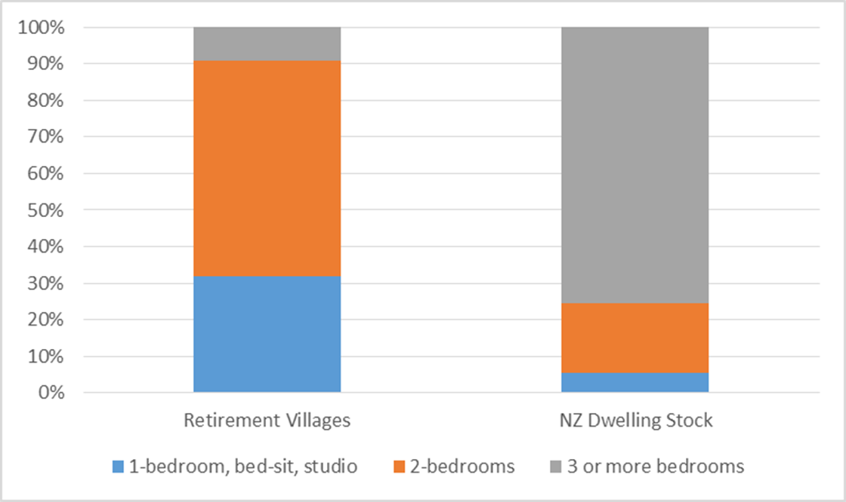
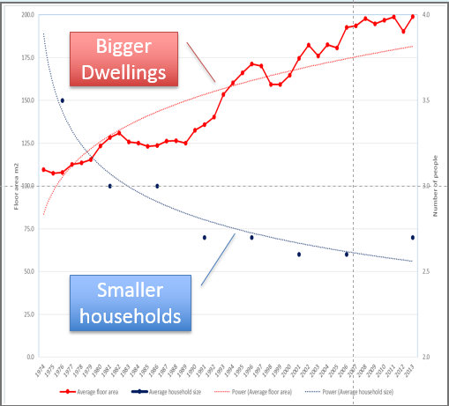
Stock Counts in Getting at the Action

Slide 13
New alliances, networks and collaborations
Service alliances
  Community sector including
    Disability resource centres
    Age concern
    CAB
    Budget services
    Men’s sheds
  In-home care services
  Public agencies
    ACC
    Ministry of Health
    Councils
    MSD

Slide 14
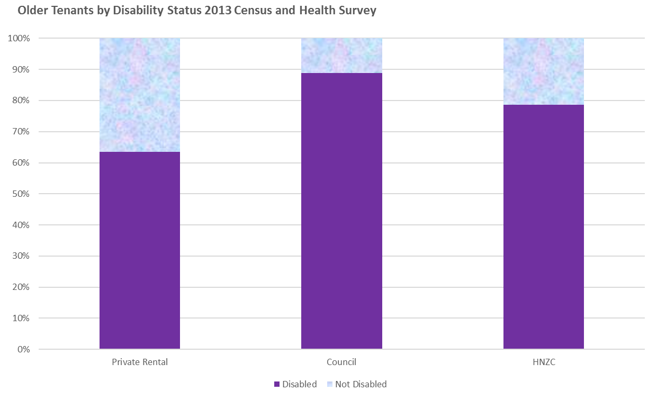

Slide 15
Reducing Complexity
De-coupling tenancy management from building ownership
  Property agents
  Public housing – HNZC lease backs
  Social housing
    Opportunities for leaseback
    Opportunities for CHO management
    Looking to expand
Contributing and getting a share
  Investment is often about investing in managed funds
  Private investment in social housing not typical in NZ
  Social housing providers (CHOs) looking to expand from 5,000 units:
    Access to IRR
    Wrap-around services
    Looking for capital

Slide 16
Responding to new demand and new challenges
Limited rent rise and high house price threats
Competition from rising sectors – student housing providers and possibly RVs
Potential problems of succession planning and exit for property investors
Ways forward:
  Good landlord accreditation
  Accessible homes – LifeMark
  ‘Right-size’ stock
  Secure tenancies
  Investing in social housing partnerships
    Improved margins
    Development opportunities
    Integrated site management
    Integrated tenant management

Slide 17



Slide 18
Ageing Well Science Challenge – Tenure Revolution Research
Component 1: Housing tenure transitions – This uses cohort analysis to establish the who, where and what of the tenure revolution.
Component 2: Tenure, in-home and residential care transitions – This component tests whether:
  Older renters are more likely to move (and/or move earlier) into residential care than older people in owner occupation or license to occupy dwellings;
  Older renters are less likely to access in-home care; and
  Older renters are less likely to access home modifications.

Slide 19
Ageing Well Science Challenge – Tenure Revolution Research
Component 3: A National Perspective on Older Renters in Policy, Planning and Services – This component uses two methods:
  Cross-sectoral Reviews: (a) central government policy, funding, and services in the health and disability sector (including residential care and home modifications), income support, social services, and housing; (b) Regional and local councils. Comprising of documentary analysis of strategies, statutes, service frameworks and practices, and provisions to increase older people’s financial independence (eg., through rates relief and deferral, warm homes subsidies, pensioner housing programmes).
  National Landlord Survey. The community and public housing will have a census. Private sector landlords will be accessed through a census of regional property investor association memberships.

Slide 20
Ageing Well Science Challenge – Tenure Revolution Research
Component 4: Case Studies – Case studies to establish the implications of the tenure revolution in diverse contexts and conditions.
  Three place-based studies
  Older tenants in council housing
  Māori rural and urban experience
  Pacific experience
  Chinese new settlers

Slide 21
Ageing Well Science Challenge – Tenure Revolution Research
Component 5: Learning to Adapt – Bringing older people and other stakeholders together using foresight methods and charrettes to:
  Explore alternative development paths and their probabilities;
  Generate consensus about the practices and services needed to optimise older people’s societal engagement, personal, familial and intergenerational wellbeing in the context of both structural ageing and declining home ownership;
  Develop tools, models and best practice that allow services to assess and adapt current services, practices, and procedures to meet the needs and circumstances of older renters, their families and communities.

