Slide 1

Many thanks to all our sponsors

Slide 2
Compliance and Investigations
Our approach to regulating the Residential Tenancies
Act 1986
Presented by Steve Watson
National Manager
Residential Tenancy and Community Housing
Compliance & Investigations Team
New Zealand Property Investors Federation Conference 2017
15 October 2017

Slide 3
    Tenancy compliance and investigation

Slide 4
Our Mission
“We will add value to the tenancy sector by being an effective an effective regulator, performing audits, investigations and building relationships with key stakeholders. We will achieve sustained compliance with the Residential Tenancies Act, increasing tenancy literacy and improve the rental experience in New Zealand. “

Slide 5
Current context
It’s a growing market; half of all New Zealanders live in rented accommodation
80% of tenancies have private sector landlords
150,000 vulnerable (low income) tenants
Approximately 180,000 rental properties inadequately insulated
Approximately 120,000 properties have poor or no smoke alarms

Slide 6

MBIE service offering
Compliance and guided self-resolution
Website information and Collateral
Mediation
Investigation of serious breaches and enforcement
Resolution and information at first point of contact through the Service Centre
Sector based audits

Slide 7
Enforcement Powers
Provides MBIE greater enforcement powers, including:
Taking Tribunal proceedings without needing the consent of the tenant
Requesting copies of current or previous tenancy agreements and increasing the penalty for not providing them
Defining the documents to be kept by a landlord and tenant that must be produced if required, and how they can be used
Applying for the right to enter premises for inspection and/or testing
Publishing comments about current or former landlord. This may include landlord details and non-compliant practices (for example).

Slide 8

Tenancy Compliance & Investigations Team
Sector Strategies
Sector | Expectations
Community Housing providers Inc HNZ | Compliance expectations informed by CHRA registration status.
Private & Individual Investors | Being a landlord is viewed as running a small business and not seen as a ‘hobby’ or ‘retirement nest-egg’. Compliance is built into the business model. A professional business approach reflects best business practice. Business systems are in place to demonstrate compliance with the RTA. Tenants as a customer are placed at the centre of the business model.
Property Management companies | encompassing the business disciplines mentioned above Businesses are run as effective Property Management companies

Slide 9

Tenancy Compliance & Investigations Team
Proactive Audit Programme
Proactive Audits are a key deliverable in the TCIT Business plan.
They are in addition to our investigation and compliance workstream.
The Audit programme is nationwide across all Sector groups.
They are designed as a “point in time” health check to check compliance with landlord obligations under the Act.
They focus on best practice as well as day-to-day requirements associated with being a landlord.
TCIT staff visit the business premises and speak to staff and review documentation and processes. Individual premises are not a part of this process.
Tenancy documentation can be requested to be provided if required. The ability to request is made under s123A of the Act.

Slide 10
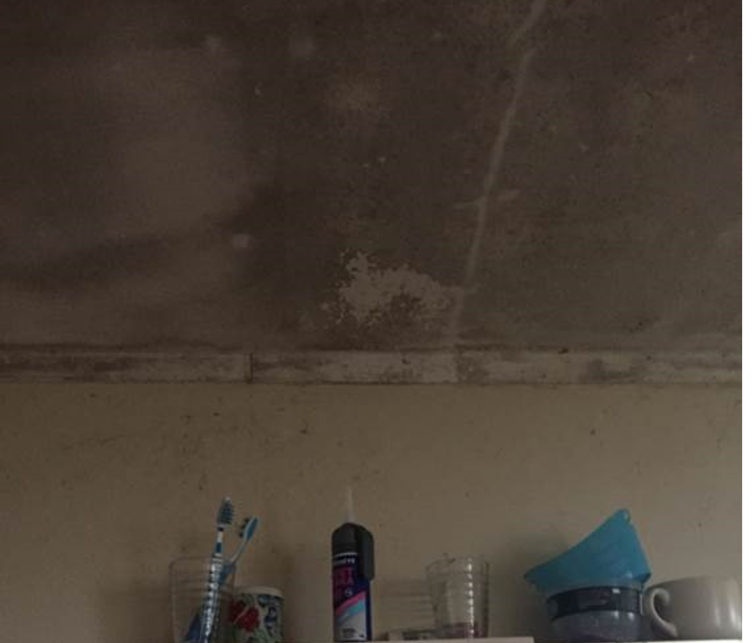
Examples of what we see in our work
Mould from leaky pipe in ceiling
Rotten framing near light-fitting

Slide 11
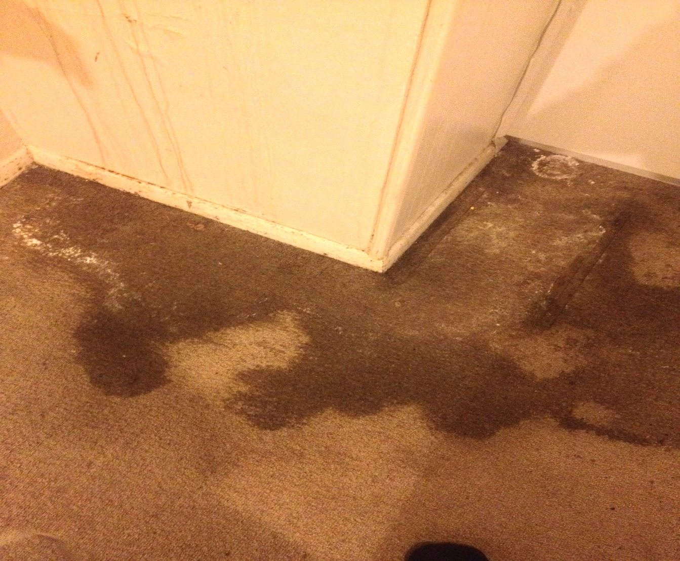
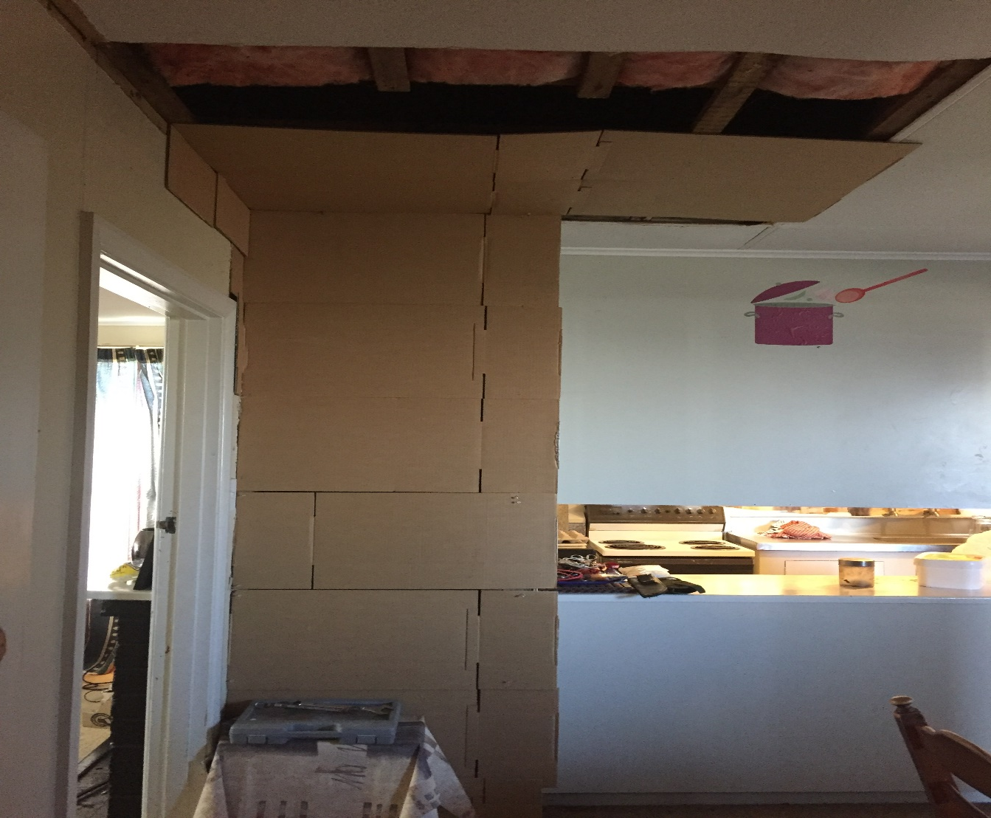
Examples of what we see in our work
Wall not fixed for over 12 months.
Tenant covered over with cardboard.
Mould in carpet from internal leak

Slide 12


Strategic objectives cont.
Landlords and tenants have good tenancy literacy
All landlords treat their enterprise as a “Business” and actively manage it

Slide 13

Key deliverables
Identify non-compliance and Breaches RTA
Investigate all complaints to a high standard and complete appropriately
Change behaviour – increase compliance – improve tenancy literacy
Build capability and capacity to enhance and embed our reputation as regulator and to meet demand for service
Promote the value of complying with Tenancy Standards
Improve effectiveness through joint work and co-production

Slide 14
Questions and answers
?

Slide 15
Many thanks to all our sponsors

