Slide 1

Many thanks to all our sponsors

Slide 2

the key to success in life & business

Slide 3


Slide 4

Helping you have a Thriving business while still looking after YOU
Connections, Collaborations & Courage

Slide 5

Keeping the
Love
Alive
Be
Where
You
Are

Slide 6

Helping you have a Thriving business while still looking after YOU
Connections, Collaborations & Courage

Slide 7

Know
Your
Goal

Slide 8

Know
Your
Goal

Slide 9
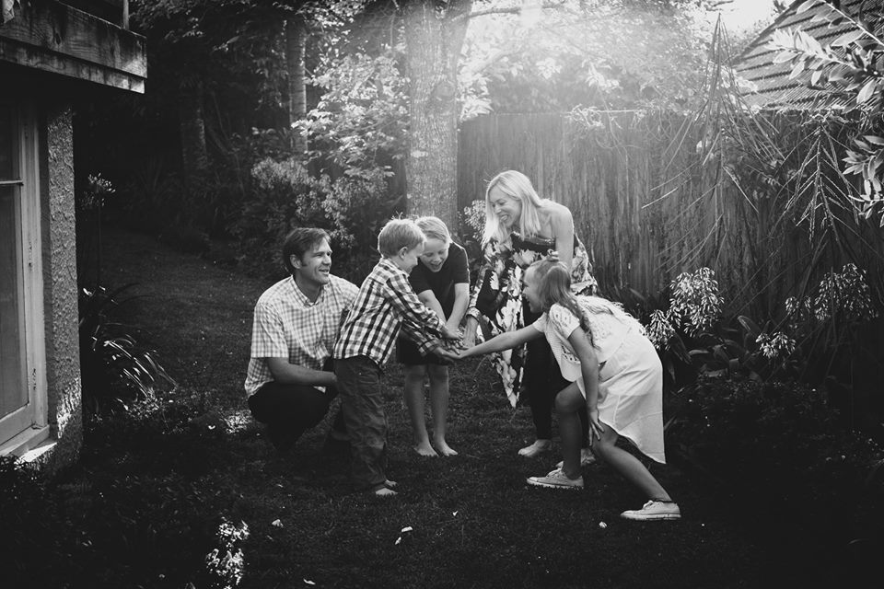
Team Cutler-Welsh
3 new customers
$7K/month
In bed by 10pm
1 date night a month

Slide 10



Celebrate your Wins
and
Your Challenges
@gotogirlnz

Slide 11

Up Your Impact
Educate
Entertain
Inspire
Invite (call to action)

Slide 12
More… LESS…
Grateful Rushing
Present Pushed
Love Stress
Leverage Hustle
Want Should

Slide 13
Say What You WANT

Slide 14
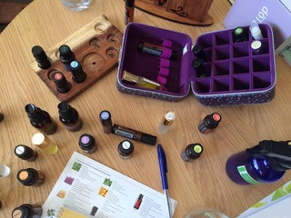
Journal
Meditation
Affirmations
Planking
Eat well
Get outside
Essential oils
Be
Where
You
Are

Slide 15

Create #winwin Opportunities

Slide 16
Say What You WANT

Slide 17
Up Your Impact
Educate
Entertain
Inspire
Invite (call to action)

Slide 18
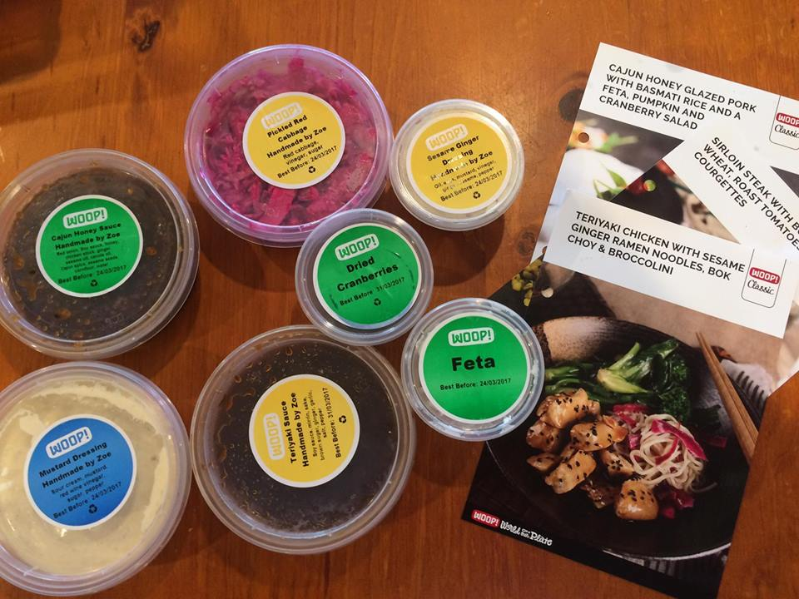
#GiveGiveGet
Do What You LOVE
Attitude of Gratitude

Slide 19
#GiveGiveGet
Do What You LOVE
Attitude of Gratitude

Slide 20
#GiveGiveGet
Do What You LOVE
Attitude of Gratitude

Slide 21


Systems

Slide 22
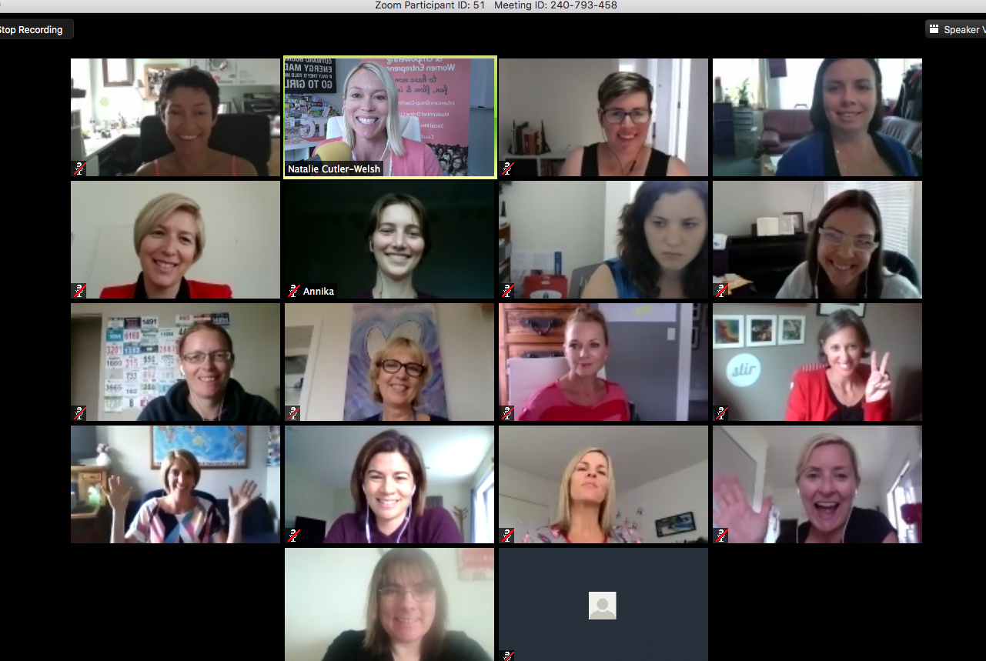

Zoom for Online Trainings/Meetings
Word Swag
Canva
Trello
Slack
Repost
Zoom

Slide 23
the key to success in life & business

Slide 24



$150 Value Giveaway!

Slide 25

Social Media platforms for your
Property Business

Slide 26
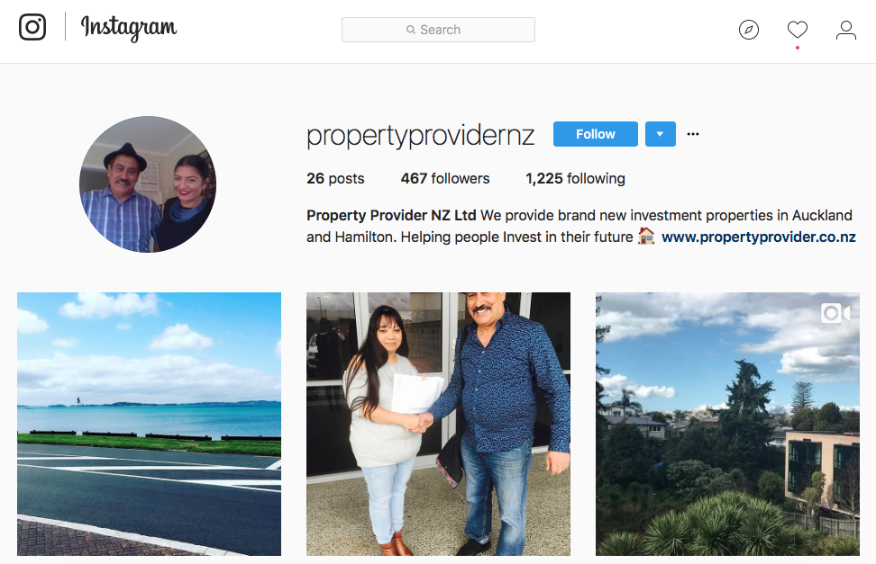
Systems

Slide 27
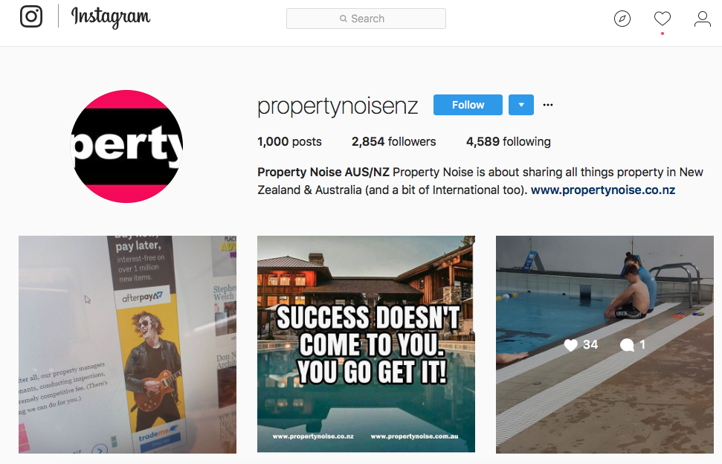
Systems

Slide 28
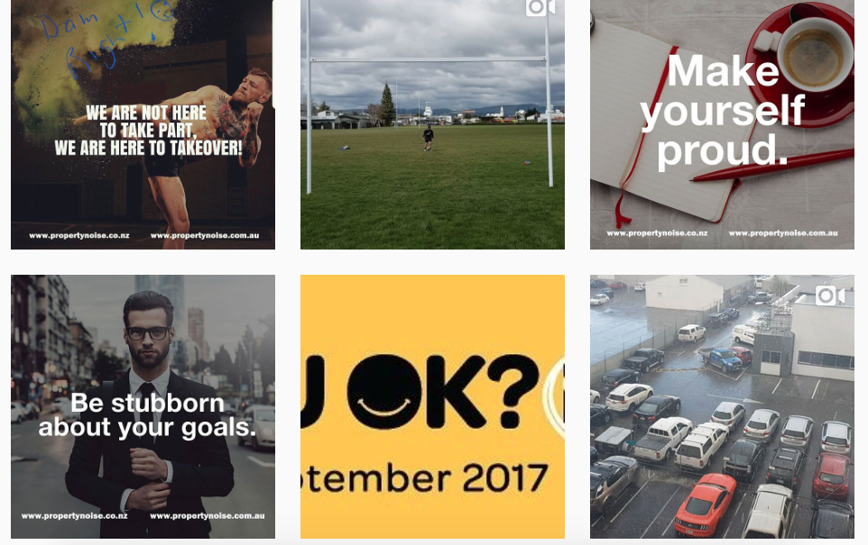
Systems

Slide 29
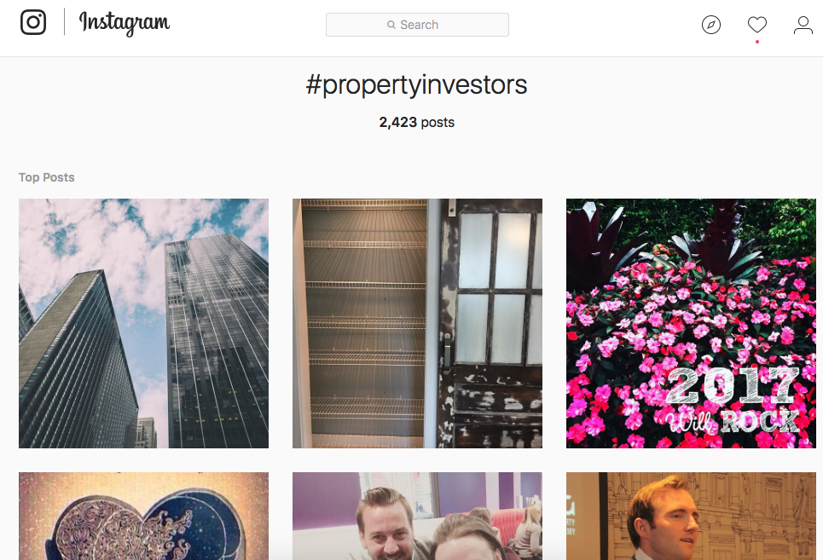
Systems

Slide 30
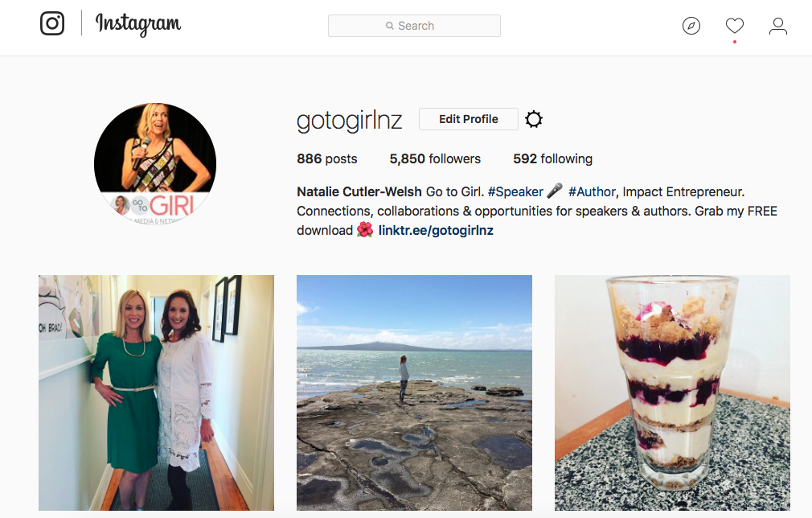
Systems

Slide 31
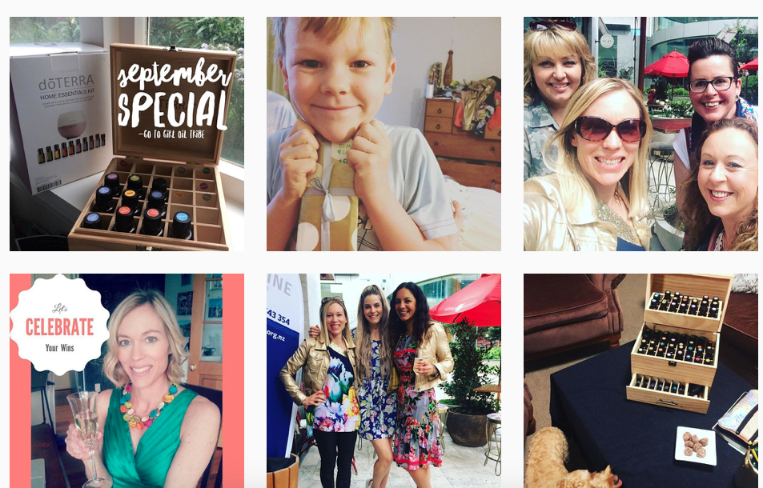
Systems

Slide 32

Graphic Design Apps

Slide 33
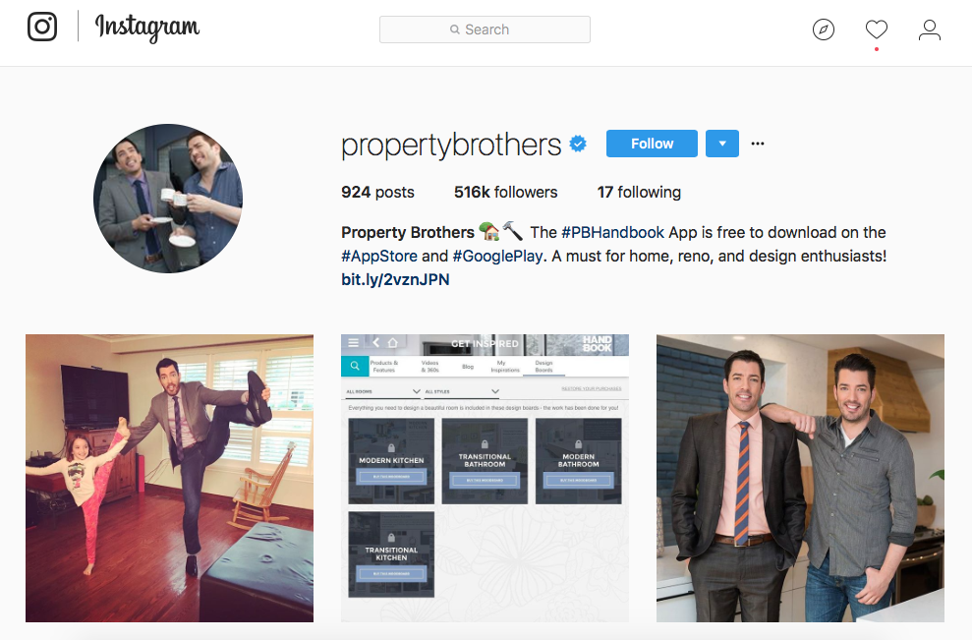
Systems

Slide 34
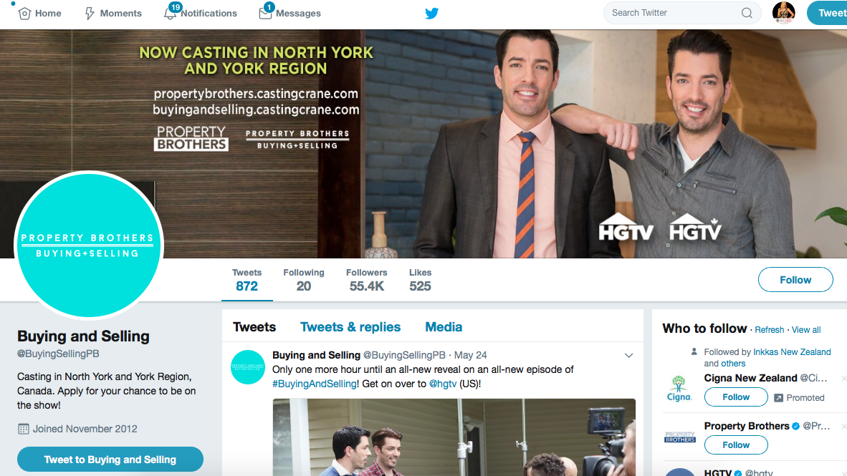
Systems

Slide 35

Systems

Slide 36
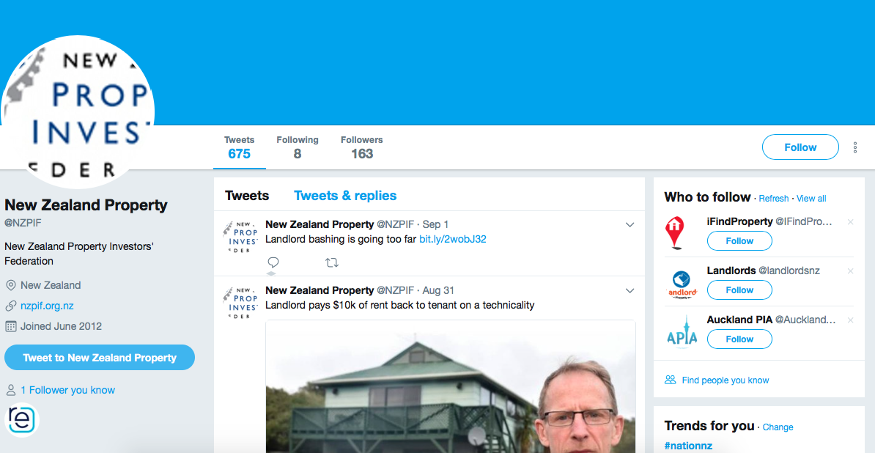
Systems

Slide 37
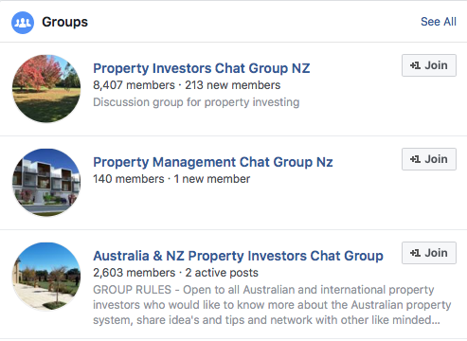
Systems

Slide 38
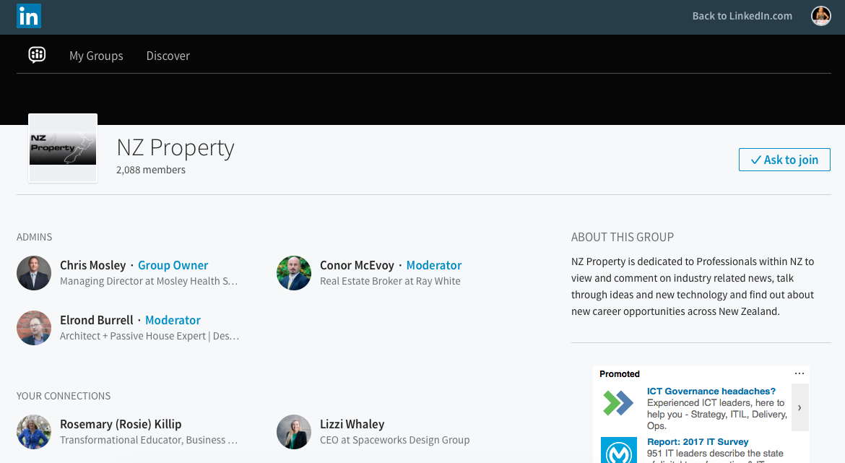
Systems

Slide 39
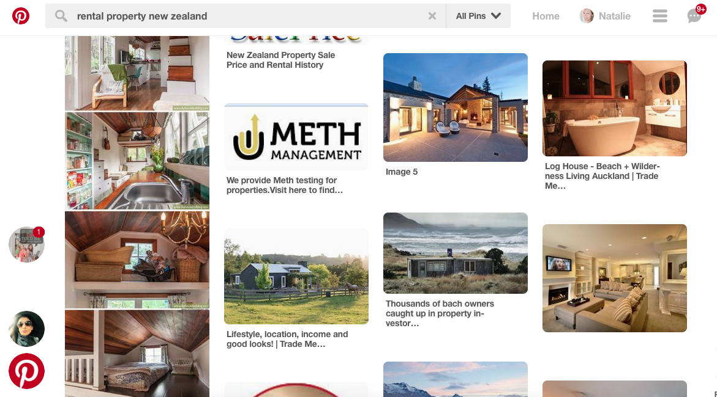
Systems

Slide 40

Graphic Design Apps

Slide 41
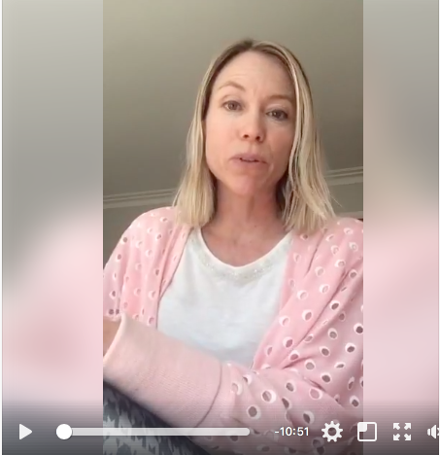
Why Facebook Live?
Priority in Newsfeed
Massive Organic reach
Flip the camera
Embed on website

Slide 42
HOW Facebook Live?
Walk through tours
In to event, group, page
Live Q&A
Trainings
How to’s
Top tips

Slide 43

HOW Facebook Live?
Walk through tours
In to event, group, page
Live Q&A
Trainings
How to’s
Top tips

Slide 44
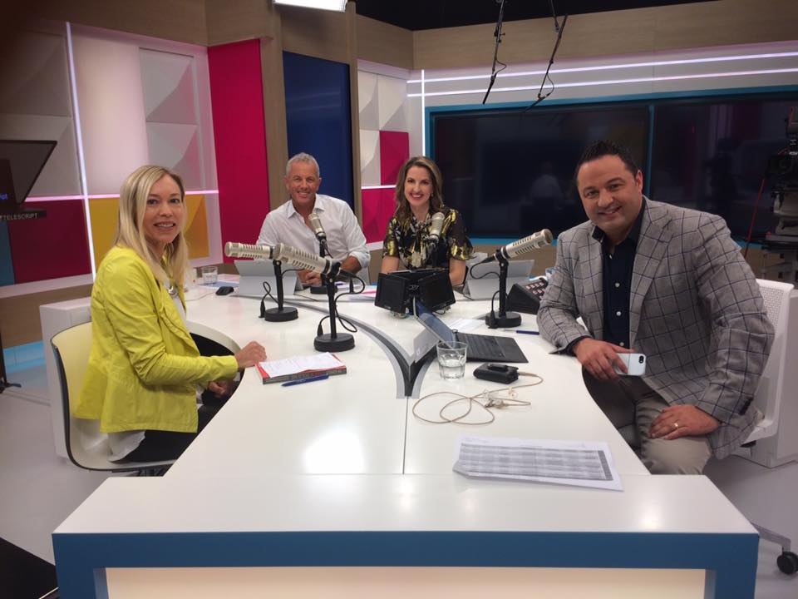
Be Seen & Heard
Educate
Entertain
Inspire
Invite (call to action)

Slide 45
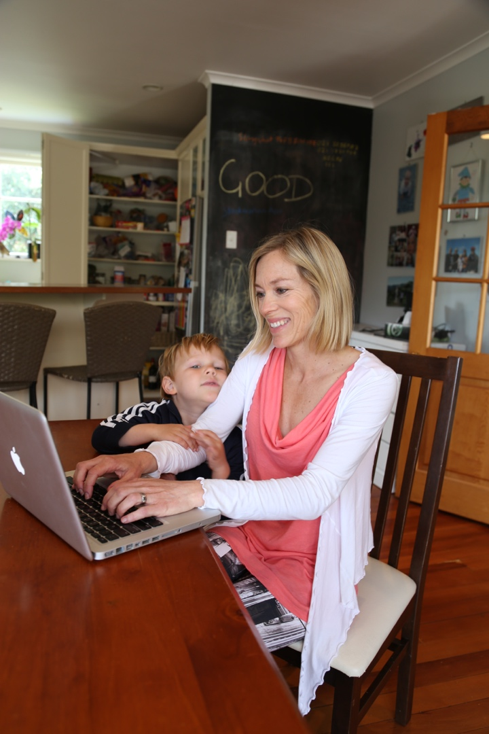
Create #winwin Opportunities
Boundaries ie 5-8pm NO TECH rule

Slide 46
Turn to
Neighbour
What is ONE thing that you’re going to take action on this week?
Self-care, Systems or Social Media?

Slide 47
Takeaways…
Hustle & Flow (Give, Give, Get)
Know your Goal/Why
Self Care
Systems
Social Media
Tech free time

Slide 48
Take-Aways…
Hustle & Flow (Give, Give, Get)
Celebrate Wins & Challenges
Say & Do what you WANT

Slide 50
Follow & Tag
@gotogirlnz

Slide 51


Networking…
Discussion & Questions?
Discussion & Questions
GotoGirl.co.nz, @gotogirlnz
Discussion & Questions?

Slide 52
Many thanks to all our sponsors

