Slide 1

Many thanks to all our sponsors

Slide 2
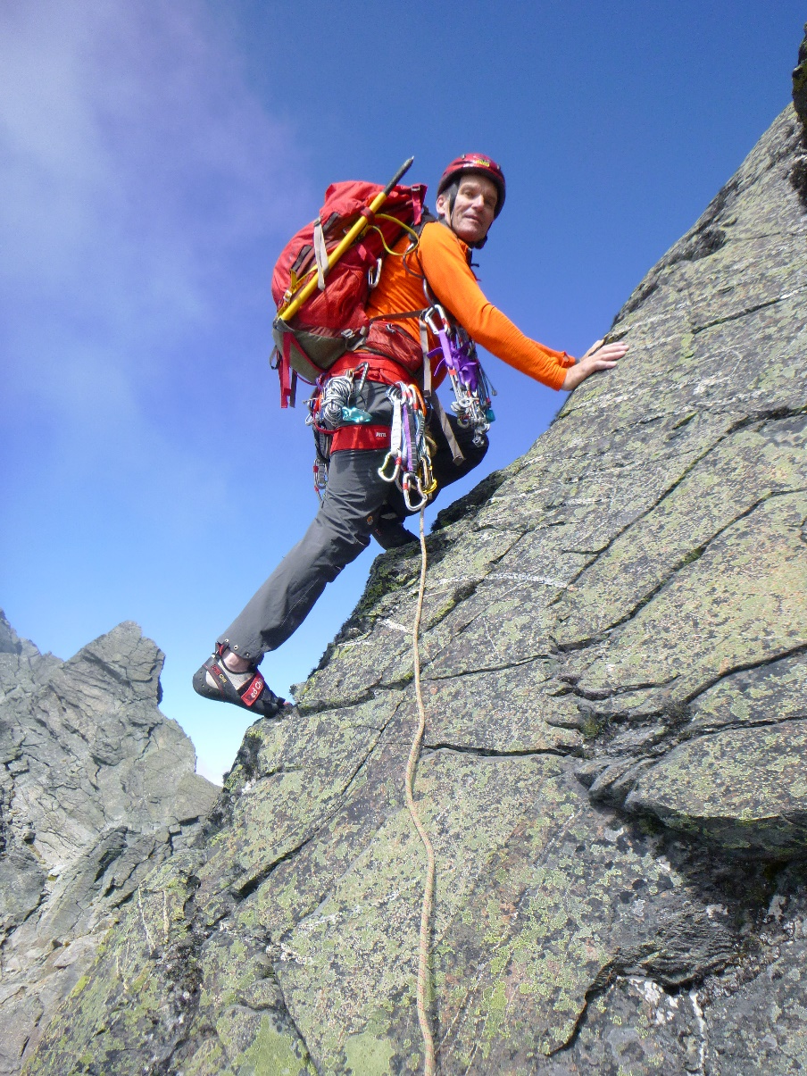
The End Game

Slide 3
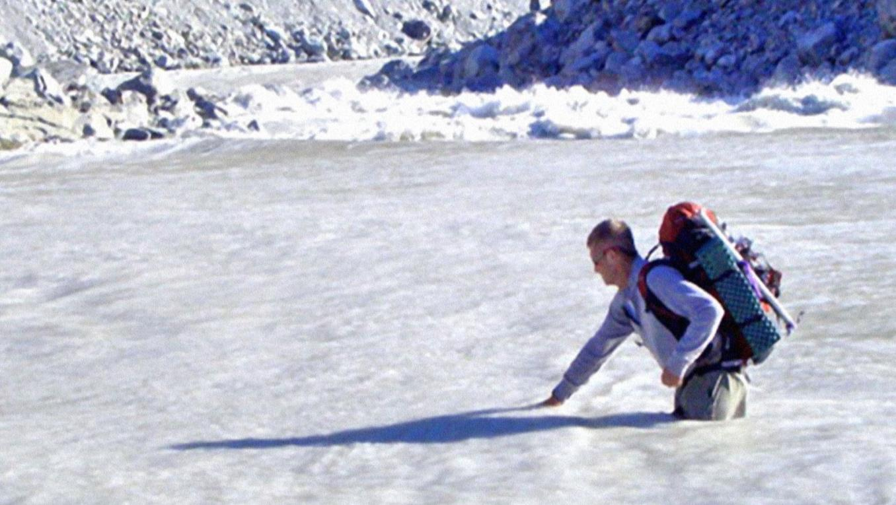
Buffett’s two rules

Slide 4
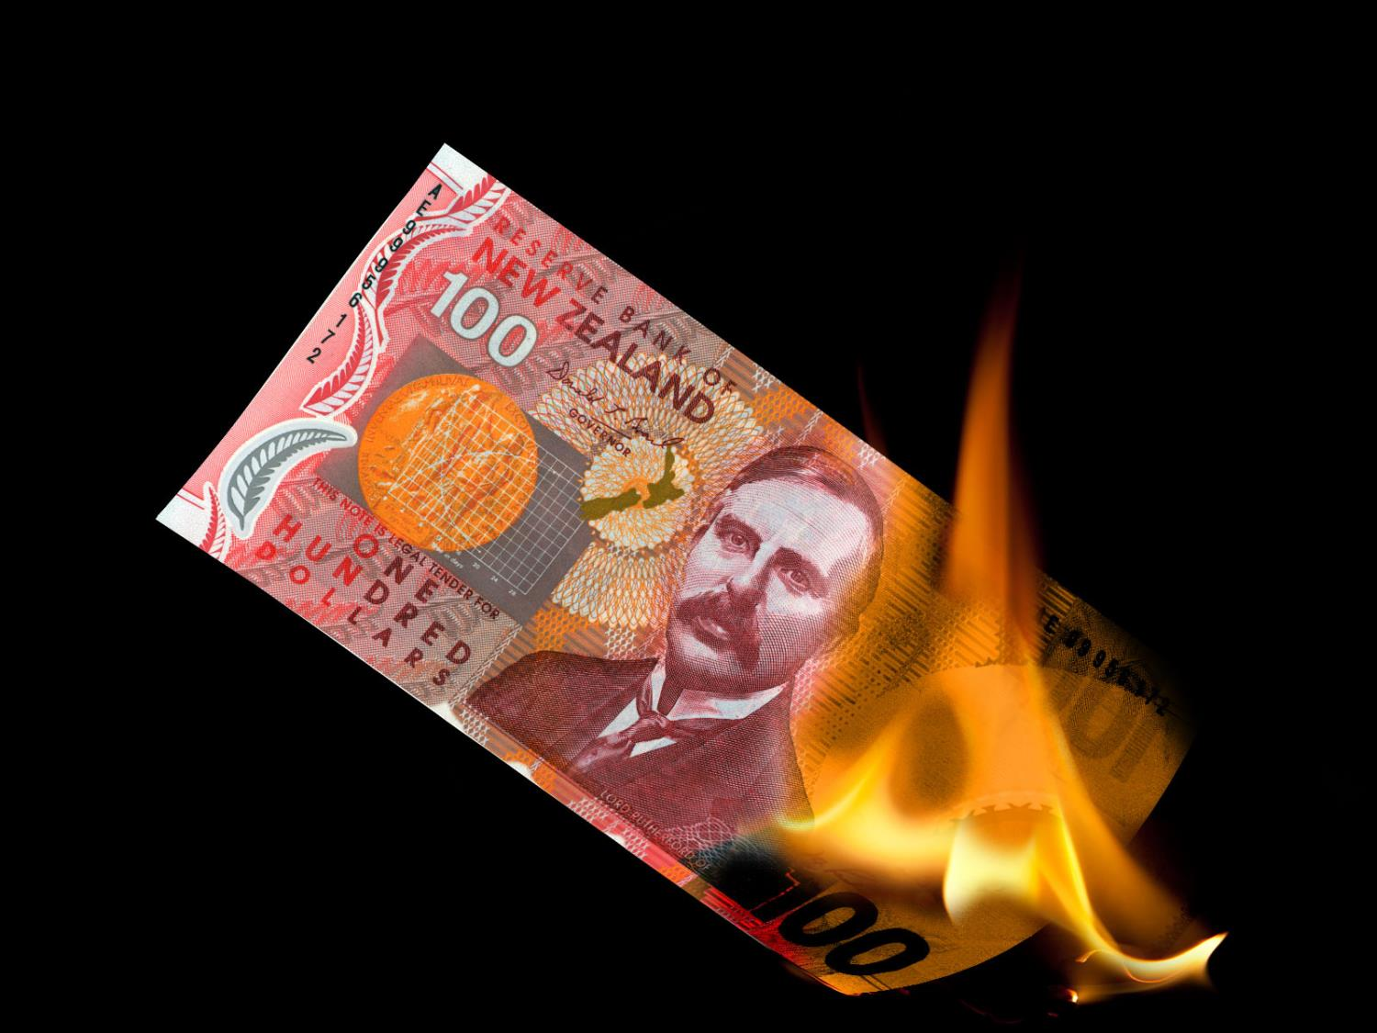
1. Don’t lose money

Slide 5

2. Remember rule #1

Slide 6
Martin Hawes
Disclosure Statement
Martin Hawes is an Authorised Financial Adviser. The views and opinions expressed in this presentation are not intended to be a personalised service for an individual retail client. The views and opinions are general in nature, may not be relevant to an individual's circumstances, and constitute a class advice only. Nothing contained in this presentation is endorsed by the Financial Markets Authority. Before making any investment, insurance or other financial decisions, you should consult a professional financial adviser.

Slide 7
Disclosure Statement
The Summer KiwiSaver scheme is managed by Forsyth Barr Investment Management Ltd.
Information about the Summer KiwiSaver scheme is disclosed in the product disclosure statement (PDS) and on the scheme and offer register entries at www.business.govt.nz/disclose
You can obtain the Scheme’s product disclosure statement and further information about the Scheme at www.summer.co.nz, from one of our offices, or by calling us on
0800 11 55 66.
Forsyth Barr Investment Management Ltd is a licenced manager of registered schemes and part of the Forsyth Barr group of companies.
The comments in this presentation are general in nature and are not personalised financial advice. If you wish to receive financial advice that is specific to your circumstances, please contact your Investment Advisor.
Disclosure statements are available from Martin Hawes and your Forsyth Barr Authorised Financial Adviser on request and free of charge.

Slide 8


Slide 9
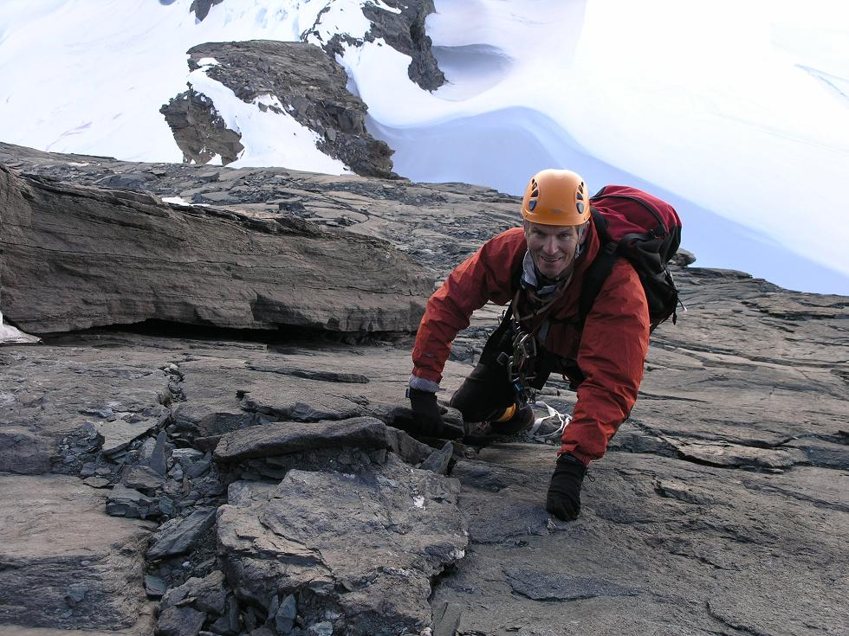

Slide 10
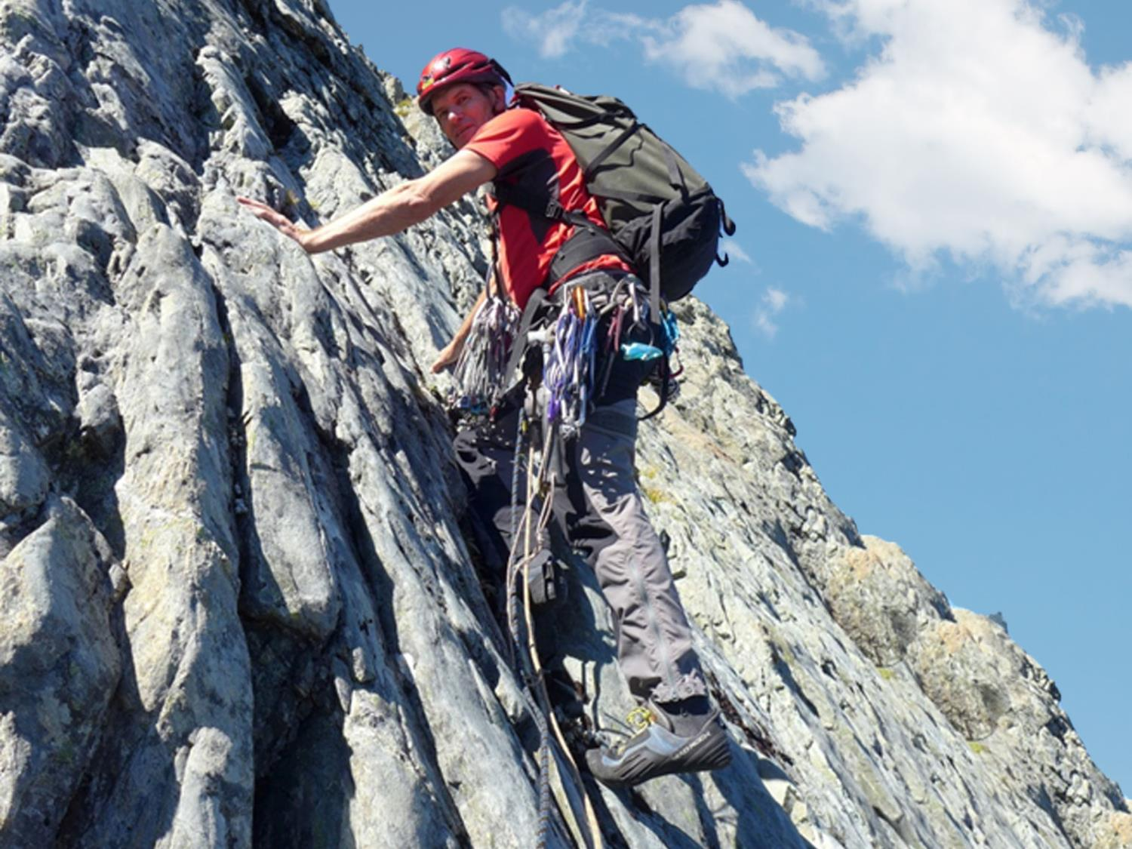

Slide 11
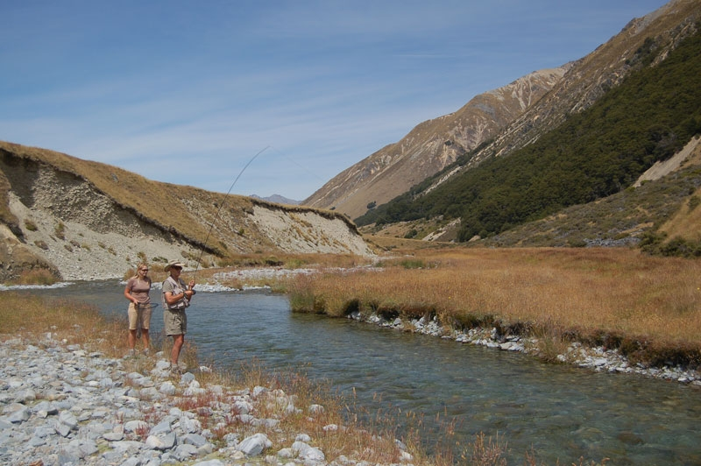

Slide 12
The End Game
Martin Hawes

Slide 14
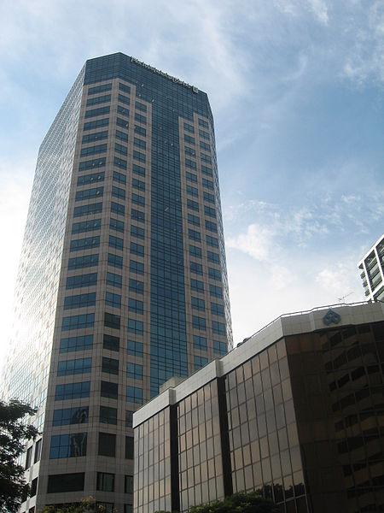

Slide 16
The End Game
Martin Hawes

Slide 17
Conservative
70
30

Slide 18
Balanced
50
50

Slide 19
Aggressive
20
80

Slide 20
Kamikaze
100

Slide 21
Inflation
Property

Slide 22
Deflation
Bonds

Slide 23
Recession
Bonds + Cash

Slide 24
Economic Boom
Shares + Property

Slide 25
NZ specific event
International investments

Slide 27

‘I don’t have time’ is the grown-up equivalent of
‘the dog ate my homework’

Slide 28
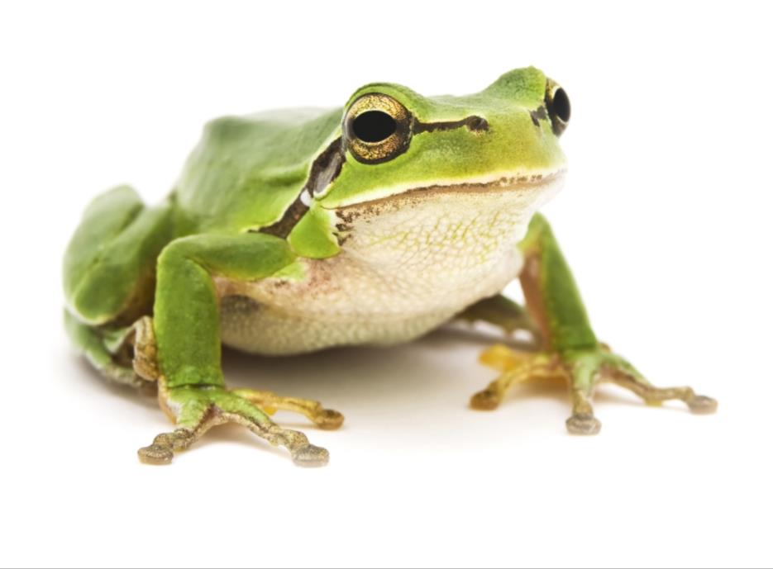
Eat Your Frogs!
Notes:
American novelist Mark Twain said:
If the first thing you do in the morning is eat a live frog, you can go through the rest of the day knowing the worst is behind you.
Your frog is your worst task, and you should do it first thing in the morning.

Slide 29
The End Game

Slide 30
Many thanks to all our sponsors

